Slide 1
Lecture 1. Preliminaries

Slide 2
Preliminaries
1.1 AI vs ML vs Deep Learning
1.2 Elements of a Machine Learning Program
1.3 Examples of Machine Learning Programs
1.4 Capacity, Overfitting, and Under-fitting
1.5 Hyper-parameters and Validation Sets

Slide 3
AI, Machine Learning, and Deep Learning
In the past few years, Artificial Intelligence (AI) has been subject of intense media hype.
Machine learning, deep learning, and AI come up in countless articles.
We’re promised a future of intelligent chatbots, self-driving cars, and virtual assistants
It is important to be able to recognize the signal in the noise so that you can tell world-changing developments from overhyped press releases
In this lecture we give an overview of AI from early AI to machine learning and briefly go over basic structure of a machine learning program.
This lecture is mostly based on chapter 5 of Goodfellow et. Al.

Slide 4
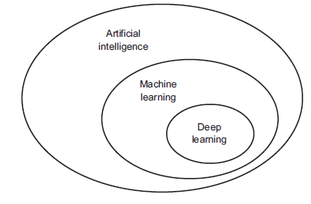
AI vs Machine Learning vs Deep Learning

Slide 5
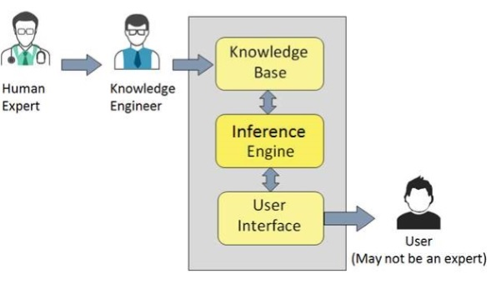

What is Artificial Intelligence
AI was born around 1950 when a handful of CS pioneers started to ask if computers can be made to think
AI is a broad field with focus on automating intellectual tasks typically performed by humans
AI encompasses both machine learning and deep learning
Early AI did not involve learning but focused on handcrafting a set of explicit rules for manipulating knowledge.
This approach was known as symbolic AI or knowledge-based approach and was the dominant paradigm in 1950s-1980s reaching its peak popularity with the development of expert systems
Expert systems were essentially a set of rules crafted by domain experts and hard-coded by programmers in the computer.
Experts’ rules
are applied to data to
Give answer to user
Rule Engine
Translate expert’s knowledge into a set of rules and input it to the machine
Knowledge base
User
inputs
data
Notes:
A simple examples for

Slide 6
Challenges of Early AI
Symbolic AI proved suitable for well-defined logical problems, such as playing chess ( where the game can be described by a very brief list of completely formal rules, easily provided a head of time by the programmer).
Although creating a chess playing system that can defeat a human player (such as IBM deep blue, 1997), was a tremendous accomplishment of symbolic AI, the challenge was not due to the diﬃculty of describing the set of chess pieces and allowable moves.
Ironically abstract and formal tasks that are among the most diﬃcult mental undertakings for a human being are among the easiest for a computer
Computers have long been able to defeat even the best human chess player but only recently have begun matching some of the abilities of average human beings to recognize objects or speech
A person’s everyday life requires an immense amount of knowledge about the world. Much of this knowledge is subjective and intuitive, and therefore diﬃcult to articulate in a formal way.
One of the biggest challenges of AI is how to get this intuitive informal knowledge into the computer

Slide 7
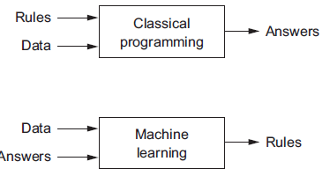
Machine Learning vs. Knowledge-Base AI
The diﬃculties faced by systems relying on hard-coded knowledge suggest that AI systems need the ability to acquire their own knowledge, by extracting rules ( or patterns) from raw data. This capability is known as machine learning
Machine learning arises from this question: could a computer go beyond “what we know how to order it to perform” and learn on its own how to perform a specified task? In other words, Rather than programmers crafting data-processing rules by hand, could a computer automatically learn these rules by looking at data?
This question opens the door to a new programming paradigm.
In classical programming, the knowledge base approach, human inputs hard-coded rules ( i.e., program) and data to be processed according to this rules and the machine computes the answers
In machine learning paradigm, human inputs data as well as the answers expected from the data and machine computes the rules

Slide 8

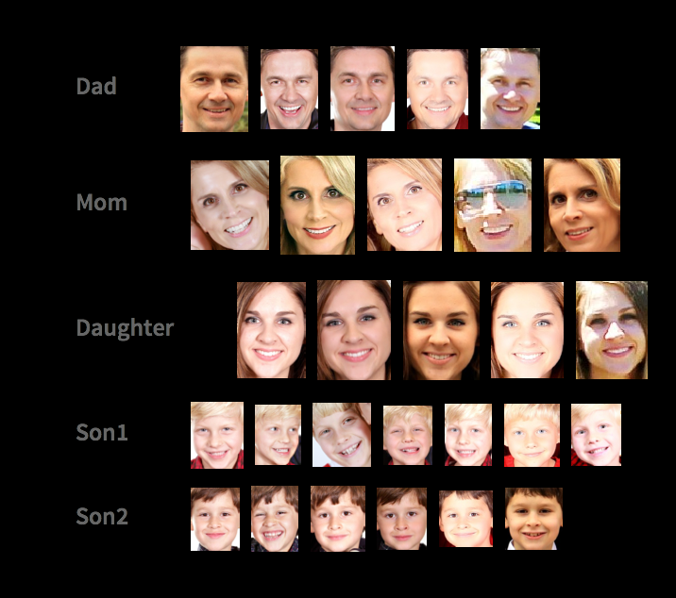
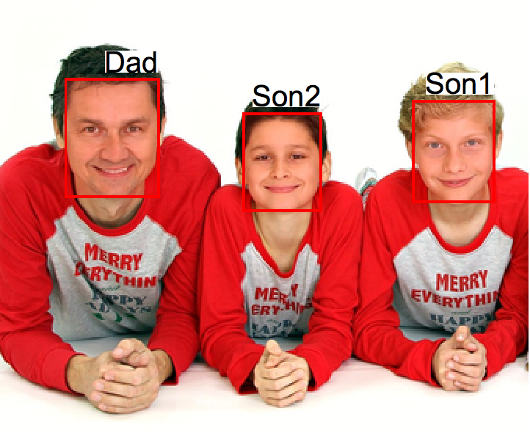
Machine Learning vs Knowledge-based AI (Cont.)
A machine learning system is trained rather than explicitly programmed with rules
A machine Learning model is presented with many examples relevant to the task, learns the statistical structures in those examples, and allows the system with rules to automate the task.
For example if you wished to automate the task of tagging your vacation pictures, you could present a machine-learning system with many examples of pictures already tagged by humans, and the system would learn statistical rules ( or a function) for associating specific pictures to specific tags.
New Iamge
Query: Who is in this image?
input
A function (aka model) that relates an image to a tag
Machine Learning Program
Output
Answer

Slide 9
Terminology: Training vs Inference
In machine learning terminology, training refers to creating a function ( aka model) which relates the input to the output. This is where machines learn how to map input to the output based on a set of given examples
Inference refers to querying the machine with new input it had never seen to get the answer. This is where machines use the rules they learned in the training phase to estimate an answer to the new data.
Inference
New Iamge
Training
Query: Who is in this image?
input
A function (aka model) that relates an image to a tag
Machine Learning Program
Output
Answer

Slide 10
Preliminaries
1.1 AI vs ML vs Deep Learning
1.2 Elements of a Machine Learning Program
Example Data
Learning Algorithm
Objective function
1.3 Examples of Machine Learning Programs
1.4 Capacity, Overfitting, and Under-fitting
1.5 Hyper-parameters and Validation Sets

Slide 11
Elements of A Machine Learning Program
According to Mitchel (1997) , a Machine Learning algorithm is an algorithm that is capable of improving a computer program’s performance at some task via experience.
To train a machine learning program we need three things;
Example Data : For instance if the task is speech recognition, the example data could be human-generated transcripts of sound files. If the task is image tagging, this could be example pictures of what we want to tag.
Learning Algorithm : An algorithm that learns structures/patterns in the example data. For instance, in case of image tagging the learning algorithm learns a mapping between the features in the example images and their tags.
Objective Function or a way to measure the performance of the learning algorithm : This is necessary in order to understand if the function learned by the machine is doing a good job mapping input to output. The performance measure is also used as a feedback signal to improve the learning algorithm.

Slide 12
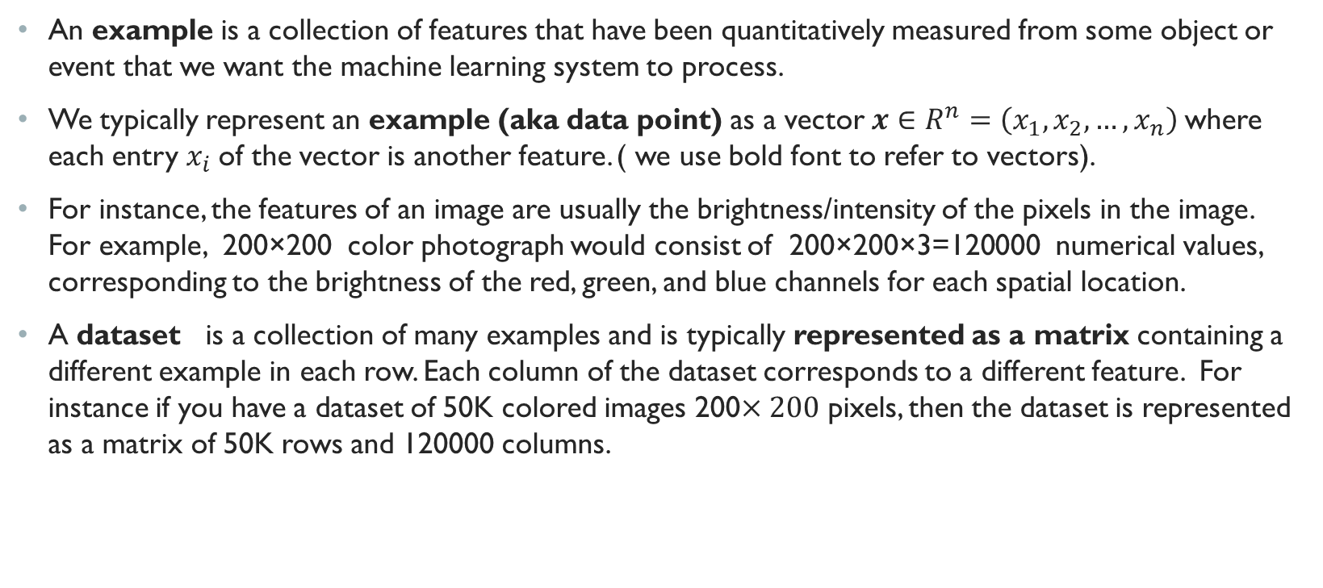
Example Data
An example is a collection of features that have been quantitatively measured from some object or event that we want the machine learning system to process.
We typically represent an example (aka data point) as a vector $x∈R^{n}=\left(x_{1},x_{2},…,x_{n}\right)$where each entry $x_{i}$of the vector is another feature. ( we use bold font to refer to vectors).
For instance, the features of an image are usually the brightness/intensity of the pixels in the image. For example, 200×200 color photograph would consist of 200×200×3=120000 numerical values, corresponding to the brightness of the red, green, and blue channels for each spatial location.
A dataset is a collection of many examples and is typically represented as a matrix containing a different example in each row. Each column of the dataset corresponds to a different feature. For instance if you have a dataset of 50K colored images 200$×200$ pixels, then the dataset is represented as a matrix of 50K rows and 120000 columns.

Slide 13
Quantity of Example Data
When we have more data, we typically can train more powerful models and rely less heavily on pre-conceived assumptions
The regime change from (comparatively) small to big data is a major contributor to the success of modern deep learning.
many of the most exciting models in deep learning (such as text processing, image recognition, object detection, speech recognition, etc. ) do not perform well without large datasets. Some others work in the low-data regime, but are no better than traditional approaches.

Slide 14
Quality of Example Data
While it is important to have enough data, it is more important to have right data.
if the data is full of mistakes, or if the chosen features are not predictive of the target quantity of interest, learning is going to fail hence, the famous saying garbage in, garbage out
Poor predictive performance is not the only potential consequence of models with poor quality data. In sensitive application of machine learning such as predictive policing, resume screening, loan risk assessment, etc. we have to be especially careful of data that reinforces social biases and discrimination
One common failure occurs in dataset where some groups of people are underrepresented or overrepresented. For example, Imagine applying a skin cancer recognition system in the wild that had never seen black skin before or applying a predictive policing system that is trained by data in which communities of colors are over represented.

Slide 15
Preliminaries
1.1 AI vs ML vs Deep Learning
1.2 Elements of a Machine Learning Program
Example Data
Learning Algorithms
Supervised vs unsupervised vs semi-supervised vs reinforcement
Parametric vs non-parametric
Objective Function
1.3 Examples of Machine Learning Program
1.4 Capacity, Overfitting, and Under-fitting
1.5 Hyper-parameters and Validation Sets

Slide 16
Learning Algorithm
The learning algorithm process examples to extract patterns/rules.
The patterns/rules extracted by learning algorithm is called a model . A model can be used to transform data and perform inference on new data.
There are three main branches of Learning Algorithms:
Supervised learning
Unsupervised Learning
Reinforcement Learning

Slide 17
Learning Algorithms: Supervised Learning
This is by far the most common type of learning algorithm and it consists of learning to map input data to known targets ( called labels, or annotations), given a set of examples ( often annotated by human).
In addition to the features, the example dataset for a supervised learning algorithm typically includes one or more extra columns representing the label/annotation for each data point.
The most popular types of supervised learning are classification and regression algorithms:
Classification
Regression

Slide 18
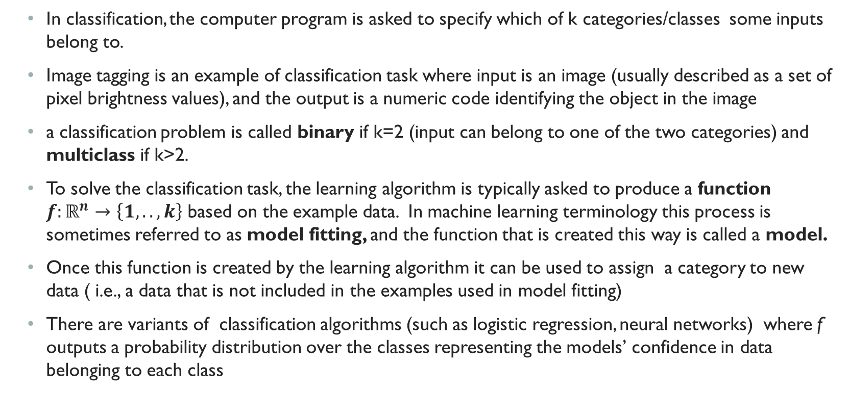
Supervised Learning: Classification
In classification, the computer program is asked to specify which of k categories/classes some inputs belong to.
Image tagging is an example of classification task where input is an image (usually described as a set of pixel brightness values), and the output is a numeric code identifying the object in the image
a classification problem is called binary if k=2 (input can belong to one of the two categories) and multiclass if k>2.
To solve the classification task, the learning algorithm is typically asked to produce a function $f:ℝ^{n}→\left\{1,..,k\right\}$ based on the example data. In machine learning terminology this process is sometimes referred to as model fitting, and the function that is created this way is called a model.
Once this function is created by the learning algorithm it can be used to assign a category to new data ( i.e., a data that is not included in the examples used in model fitting)
There are variants of classification algorithms (such as logistic regression, neural networks) where f outputs a probability distribution over the classes representing the models’ confidence in data belonging to each class

Slide 19
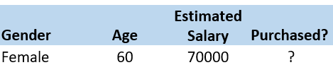
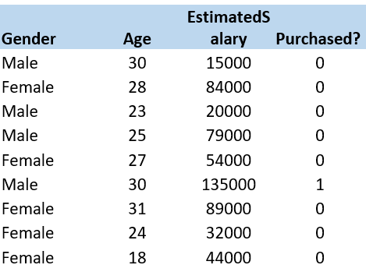
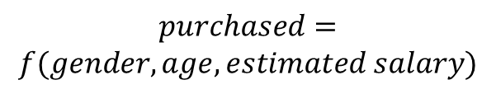
Example of binary classification
Example Data (annotated)
New x not in the example Data
f(x)
X=features
Y=Label
Classification Model
Learning Algorithm
$$purchased=$$
$$f(gender,age,estimated salary)$$
Predict
Purchased?

Slide 20
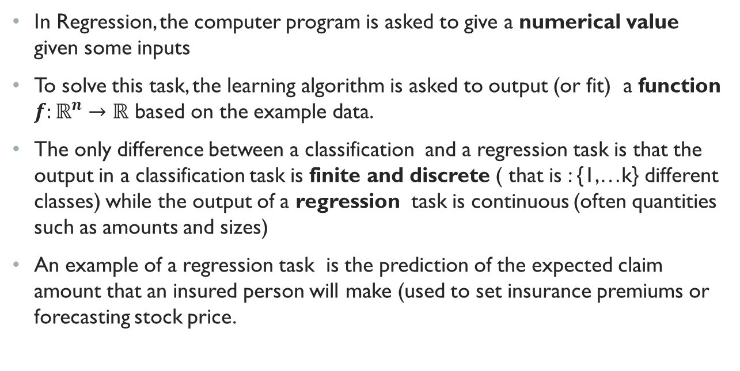
Supervised Learning: Regression
In Regression, the computer program is asked to give a numerical value given some inputs
To solve this task, the learning algorithm is asked to output (or fit) a function $f:ℝ^{n}→ℝ$ based on the example data.
The only difference between a classification and a regression task is that the output in a classification task is finite and discrete ( that is : {1,…k} different classes) while the output of a regression task is continuous (often quantities such as amounts and sizes)
An example of a regression task is the prediction of the expected claim amount that an insured person will make (used to set insurance premiums or forecasting stock price.

Slide 21
Other Examples of Supervised Learning
Although supervised learning mostly consists of classification and regression, there are more exotic variants of supervised learning, such as:
Sequence generation: where the goal is to predict a sequence of values rather than a single value.
For example, machine translation is a sequence generation problem where the input is a sentence in the original language and the output is a sentence (sequence of words) in the target language
For example, image captioning is a sequence generation problem where the input is a vector of image pixels and the output is a sequence of words describing the image
Sequence generation is sometimes formulated as a as a series of classification problems (such as repeatedly predicting a word or token in a sequence).
Object detection: where the input is an image and the output is both a bounding box around certain objects in the image and identifying the class/type of the object.
Object detection is often formulated as a combined classification/regression problem where the object bounding box coordinates are predicted using regression and then objects are tagged using classification
Syntax tree prediction: where the input is a sentence and the output is its decomposition into a syntax tree

Slide 22
Unsupervised Learning
The main difference between supervised an unsupervised learning is that in unsupervised learning, example data is not labeled ( or annotated)
The goal of unsupervised learning is to find interesting transformations of the example data for the purpose of grouping similar data, visualization, data compression, or de-noising (removing noise from a given input)
For example, given a set of un-annotated photos, can we group them into landscape photos, pictures of dogs, babies, etc. Or given a collection of users browsing activity, can we group them into users with similar behavior?
Examples of unsupervised learning algorithms are dimensionality reduction algorithms such as PCA, Auto-encoders, clustering algorithms such as Kmeans.

Slide 23
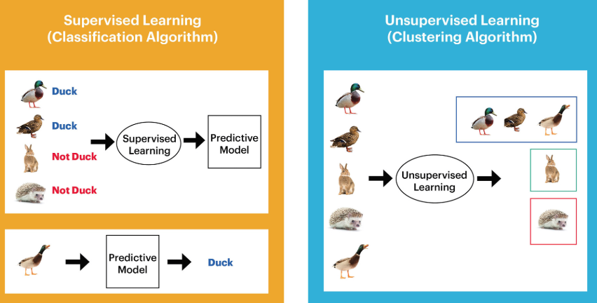
Example: Unsupervised vs Supervised Learning
Notes:
Source of the image:https://blog.westerndigital.com/wp-content/uploads/2018/05/supervised-learning-diagram.jpg

Slide 24
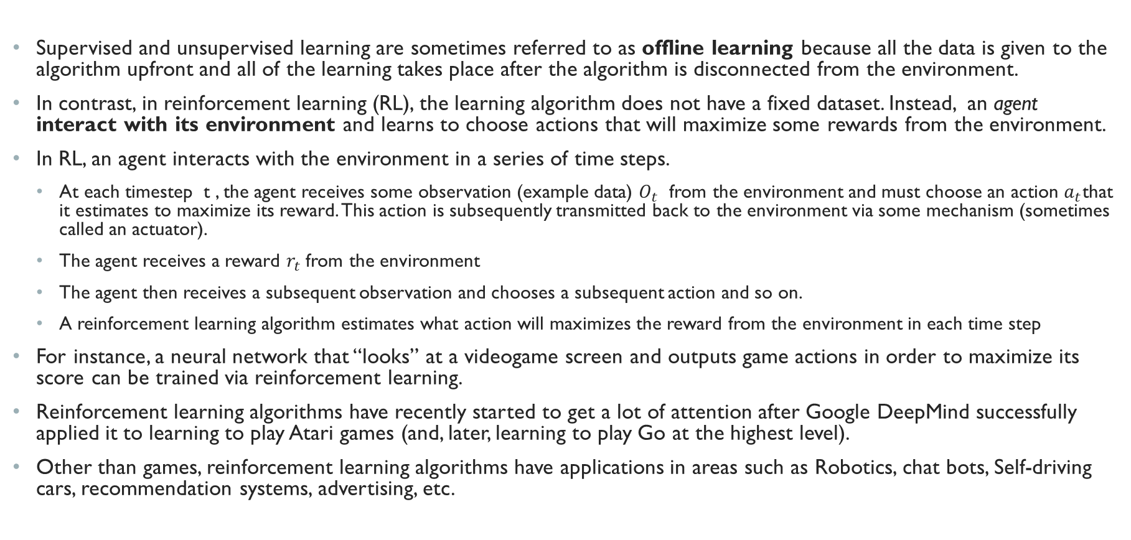
Reinforcement Learning
Supervised and unsupervised learning are sometimes referred to as offline learning because all the data is given to the algorithm upfront and all of the learning takes place after the algorithm is disconnected from the environment.
In contrast, in reinforcement learning (RL), the learning algorithm does not have a fixed dataset. Instead, an agent interact with its environment and learns to choose actions that will maximize some rewards from the environment.
In RL, an agent interacts with the environment in a series of time steps.
At each timestep t , the agent receives some observation (example data) $O_{t}$ from the environment and must choose an action $a_{t}$that it estimates to maximize its reward. This action is subsequently transmitted back to the environment via some mechanism (sometimes called an actuator).
The agent receives a reward $r_{t}$ from the environment
The agent then receives a subsequent observation and chooses a subsequent action and so on.
A reinforcement learning algorithm estimates what action will maximizes the reward from the environment in each time step
For instance, a neural network that “looks” at a videogame screen and outputs game actions in order to maximize its score can be trained via reinforcement learning.
Reinforcement learning algorithms have recently started to get a lot of attention after Google DeepMind successfully applied it to learning to play Atari games (and, later, learning to play Go at the highest level).
Other than games, reinforcement learning algorithms have applications in areas such as Robotics, chat bots, Self-driving cars, recommendation systems, advertising, etc.

Slide 25
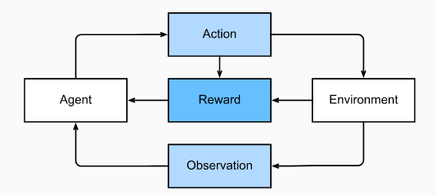
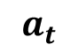
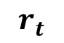
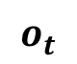
Interaction between reinforcement learning algorithm and the environment
$$a_{t}$$
$$r_{t}$$
$$o_{t}$$

Slide 26
Parametric vs Non-Parametric Learning Algorithms
Another way to categorize learning algorithm is parametric vs non-parametric algorithms
Parametric algorithms
make assumptions about the functional form or shape of the function (i.e., the model) that maps input to output (i.e., the model).
By doing so, they reduce the learning problem into estimating the parameters of model.
For example, linear regression is a parametric learning algorithm because it assumes that output is a linear function of input and reduces the learning algorithm to estimating the coefficients of the linear equation.
Parametric models assumes that the model have a fixed number of parameters.

Slide 27
Parametric vs Non-Parametric Learning Algorithms (Cont.)
Non-parametric algorithms:
Do not make explicit assumptions about the form or shape of the function that connects input to output. Instead they seek an estimate of the function that gets as close to the example data points as possible without being too rough or wiggly.
Do not have a fixed set of parameters and the number of parameters grows with the size of the example data
k-nearest neighbors and decision trees are examples of non-parametric models because they don’t make any assumption about the function that maps input to output.

Slide 28
Preliminaries
1.1 AI vs ML vs Deep Learning
1.2 Elements of a Machine Learning Program
Example Data
Learning Algorithms
Objective Function
1.3 Examples of Machine Learning Program
1.4 Capacity, Overfitting, and Under-fitting
1.5 Hyper-parameters and Validation Sets

Slide 29
Objective Function
To evaluate the abilities of a machine learning algorithm, we must design a quantitative measure of its performance.
The performance measure depends on the type of the learning algorithm and the desired behavior of the system.
For example, the performance of a classification algorithm is often measured in terms of accuracy which is just the proportion of examples for which the model produces correct output.
For example, the performance of a regression algorithm is often measured in terms of mean squared error, which is the average of squared distance between the algorithm’s output and the correct output.
In machine learning and optimization, in general, this performance measure is referred to as objective, loss, or cost function.

Slide 30
Performance Measure and Generalization
The choice of performance measure may seem straightforward and objective, but it is often diﬃcult to choose a performance measure that corresponds well to the desired behavior of the system
For example, in a regression problem should we penalize the system more if it frequently makes medium-sized mistakes or if it rarely makes very large mistakes or in a language translation task, should we measure the accuracy of the system at translating an entire sentence correctly or should we use a more ﬁne-grained performance measure that gives partial credit for getting some elements of the sentence correctly
Usually we are interested in how well the machine learning algorithm performs on data that it has not seen before, since this determines how well it will work when deployed in the real world.
We therefore evaluate these performance measures using a test set of data that is separate from the data used for training the machine learning system
The ability of a model to perform well on previously unobserved inputs is called generalization

Slide 31
Preliminaries
1.1 AI vs ML vs Deep Learning
1.2 Elements of a Machine Learning Program
1.3 Examples of Machine Learning Programs
Background: Basic Linear Algebra
Linear Regression
Background: Probability
Logistic Regression
1.4 Capacity, Overfitting, and Under-fitting
1.5 Hyper-parameters and Validation Sets

Slide 32
Basic Linear Algebra Refresher
So we said that each machine learning program consists of example data, a learning task, and an objective function. In a little bit we will talk about two simple examples of machine learning algorithms ( namely, linear regression and logistic regression) and explain each of these elements in more concrete terms.
In a later module we will see that Linear and Logistic Regression models constitute the basic building blocks of neurons in a deep learning neural network.
But before, diving into Linear and Logistic Regression models, we need a quick refresher on Linear Algebra and probability.

Slide 33
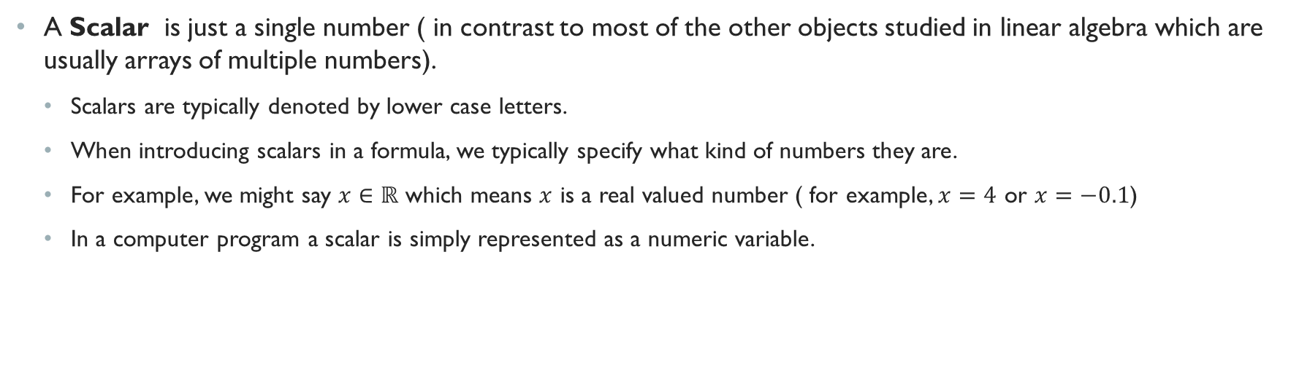
Scalars
A Scalar is just a single number ( in contrast to most of the other objects studied in linear algebra which are usually arrays of multiple numbers).
Scalars are typically denoted by lower case letters.
When introducing scalars in a formula, we typically specify what kind of numbers they are.
For example, we might say $x∈ℝ$ which means $x$ is a real valued number ( for example, $x=4$ or $x=−0.1$)
In a computer program a scalar is simply represented as a numeric variable.

Slide 34
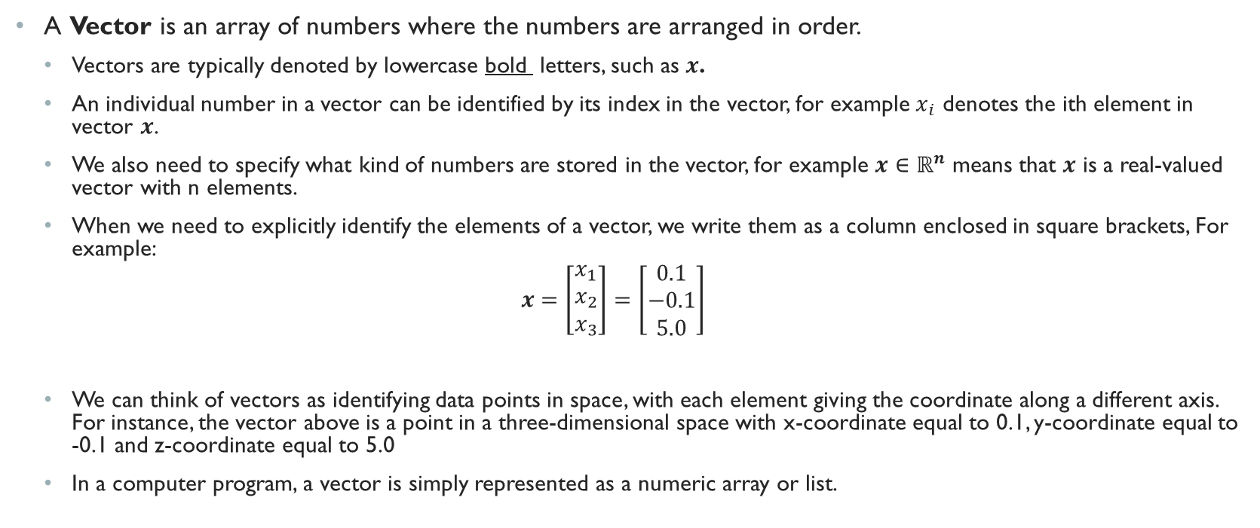
Vectors
A Vector is an array of numbers where the numbers are arranged in order.
Vectors are typically denoted by lowercase bold letters, such as $x$.
An individual number in a vector can be identified by its index in the vector, for example $x_{i}$ denotes the ith element in vector $x$.
We also need to specify what kind of numbers are stored in the vector, for example $x∈ℝ^{n}$ means that $x$ is a real-valued vector with n elements.
When we need to explicitly identify the elements of a vector, we write them as a column enclosed in square brackets, For example:
$$x=\left[\begin{matrix}x_{1} \\ x_{2} \\ x_{3}\end{matrix}\right]=\left[\begin{matrix}0.1 \\ −0.1 \\ 5.0\end{matrix}\right]$$
We can think of vectors as identifying data points in space, with each element giving the coordinate along a different axis. For instance, the vector above is a point in a three-dimensional space with x-coordinate equal to 0.1, y-coordinate equal to -0.1 and z-coordinate equal to 5.0
In a computer program, a vector is simply represented as a numeric array or list.

Slide 35
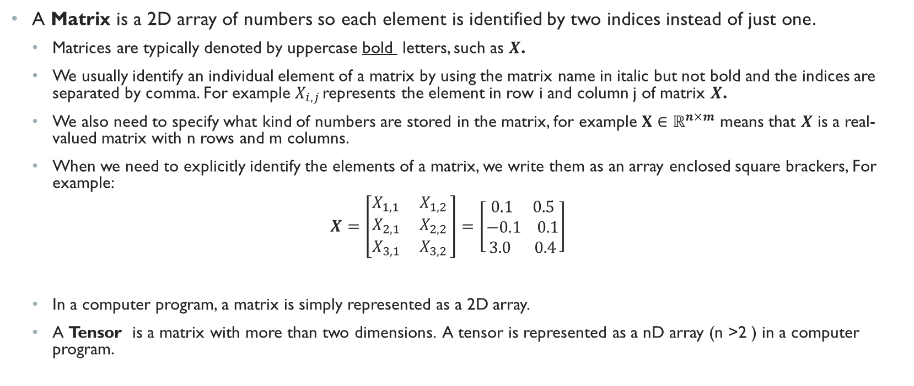
Matrices and Tensors
A Matrix is a 2D array of numbers so each element is identified by two indices instead of just one.
Matrices are typically denoted by uppercase bold letters, such as $X$.
We usually identify an individual element of a matrix by using the matrix name in italic but not bold and the indices are separated by comma. For example $X_{i,j }$represents the element in row i and column j of matrix $X$.
We also need to specify what kind of numbers are stored in the matrix, for example $X∈ℝ^{n×m}$ means that $X$ is a real-valued matrix with n rows and m columns.
When we need to explicitly identify the elements of a matrix, we write them as an array enclosed square brackers, For example:
$$X=\left[\begin{matrix}X_{1,1} X_{1,2 } \\ X_{2,1} X_{2,2 } \\ X_{3,1} X_{3,2 }\end{matrix}\right]=\left[\begin{matrix}0.1 0.5 \\ −0.1 0.1 \\ 3.0 0.4\end{matrix}\right]$$
In a computer program, a matrix is simply represented as a 2D array.
A Tensor is a matrix with more than two dimensions. A tensor is represented as a nD array (n >2 ) in a computer program.

Slide 36
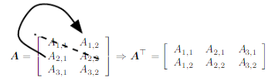
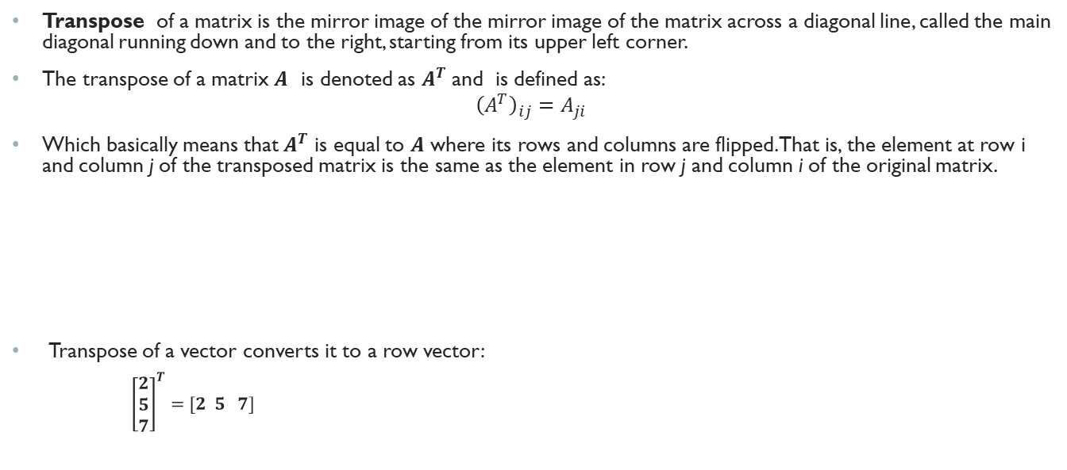
Matrix Operations: Transpose
Transpose of a matrix is the mirror image of the mirror image of the matrix across a diagonal line, called the main diagonal running down and to the right, starting from its upper left corner.
The transpose of a matrix $A$ is denoted as $A^{T}$ and is defined as:
$${\left(A^{T}\right)}_{ij}=A_{ji}$$
Which basically means that $A^{T}$ is equal to $A$ where its rows and columns are flipped. That is, the element at row i and column j of the transposed matrix is the same as the element in row j and column i of the original matrix.
Transpose of a vector converts it to a row vector:
${\left[\begin{matrix}2 \\ 5 \\ 7\end{matrix}\right]}^{T}=[2 5 7]$

Slide 37
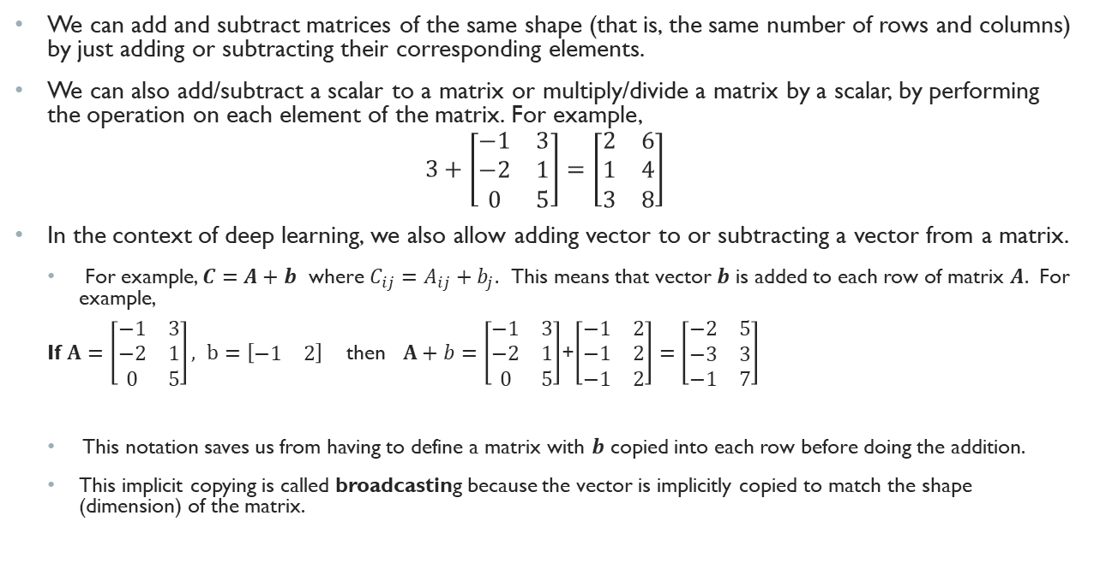
Other Matrix Operations
We can add and subtract matrices of the same shape (that is, the same number of rows and columns) by just adding or subtracting their corresponding elements.
We can also add/subtract a scalar to a matrix or multiply/divide a matrix by a scalar, by performing the operation on each element of the matrix. For example,
$$3+\left[\begin{matrix}−1 & 3 \\ −2 & 1 \\ 0 & 5\end{matrix}\right]=\left[\begin{matrix}2 & 6 \\ 1 & 4 \\ 3 & 8\end{matrix}\right]$$
In the context of deep learning, we also allow adding vector to or subtracting a vector from a matrix.
For example, $C=A+b$ where $C_{ij}=A_{ij}+b_{j}.$ This means that vector $b$ is added to each row of matrix $A.$ For example,
If $A=\left[\begin{matrix}−1 & 3 \\ −2 & 1 \\ 0 & 5\end{matrix}\right], b=\left[\begin{matrix}−1 & 2\end{matrix}\right]$ then $A+b=\left[\begin{matrix}−1 & 3 \\ −2 & 1 \\ 0 & 5\end{matrix}\right]$+$\left[\begin{matrix}−1 & 2 \\ −1 & 2 \\ −1 & 2\end{matrix}\right]=\left[\begin{matrix}−2 & 5 \\ −3 & 3 \\ −1 & 7\end{matrix}\right]$
This notation saves us from having to define a matrix with $b$ copied into each row before doing the addition.
This implicit copying is called broadcasting because the vector is implicitly copied to match the shape (dimension) of the matrix.

Slide 38
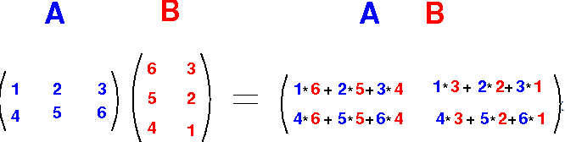
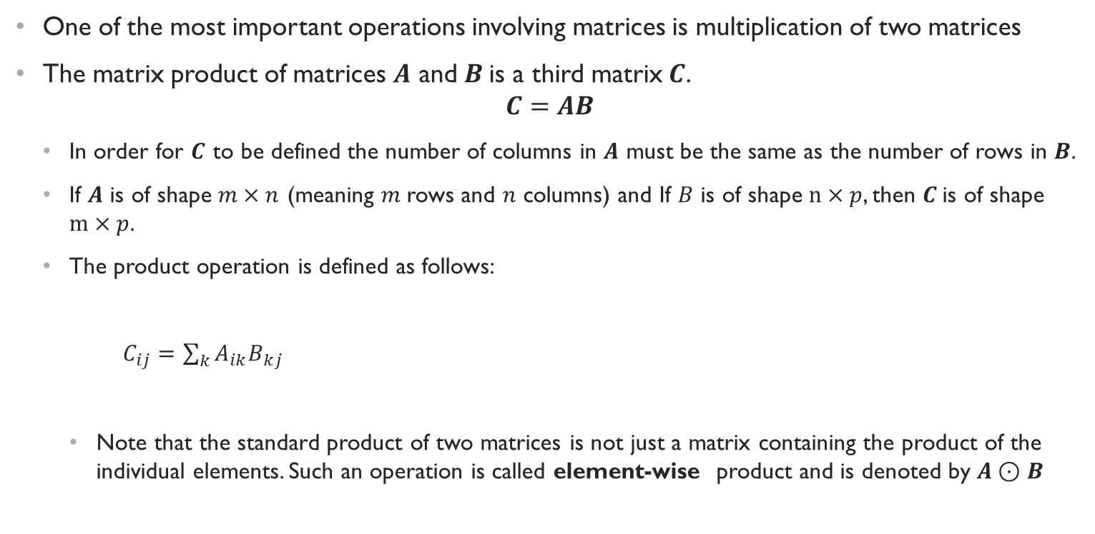

Matrix Multiplication
One of the most important operations involving matrices is multiplication of two matrices
The matrix product of matrices $A$ and $B$is a third matrix$C$.
$$C=AB$$
In order for $C$ to be defined the number of columns in $A$ must be the same as the number of rows in $B$.
If $A$ is of shape $m×n$ (meaning $m$rows and $n$ columns) and If $B$ is of shape $n×p$, then $C$is of shape $m×p$.
The product operation is defined as follows:
$C_{ij}=\sum_{k}{A_{ik}B_{kj}}$
Note that the standard product of two matrices is not just a matrix containing the product of the individual elements. Such an operation is called element-wise product and is denoted by $A⊙B$
$$×$$

Slide 39
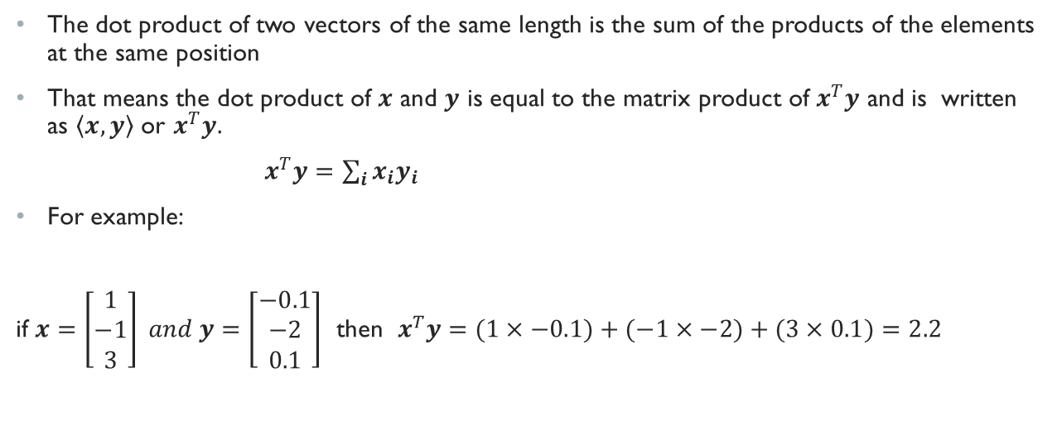
Dot Product
The dot product of two vectors of the same length is the sum of the products of the elements at the same position
That means the dot product of $x$ and $y$ is equal to the matrix product of $x^{T}y$ and is written as $\left\langle x,y\right\rangle$ or $x^{T}y.$
$x^{T}y=\sum_{i}{x_{i}y_{i}}$
For example:
if $x=\left[\begin{matrix}1 \\ −1 \\ 3\end{matrix}\right] and y=\left[\begin{matrix}−0.1 \\ −2 \\ 0.1\end{matrix}\right]$ then $x^{T}y=(1×−0.1)+(−1×−2)+(3×0.1)=2.2$

Slide 40
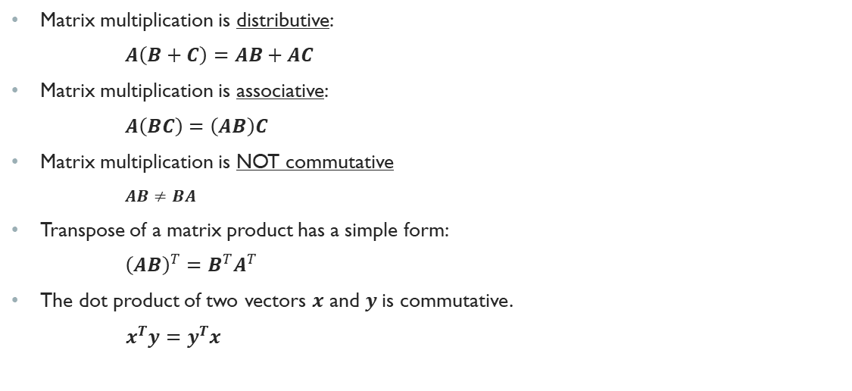
Some Properties of matrix multiplication
Matrix multiplication is distributive:
$A\left(B+C\right)=AB+AC$
Matrix multiplication is associative:
$A\left(BC\right)=\left(AB\right)C$
Matrix multiplication is NOT commutative
$AB≠BA$
Transpose of a matrix product has a simple form:
${\left(AB\right)}^{T}=B^{T}A^{T}$
The dot product of two vectors $x$ and $y$is commutative.
$x^{T}y=y^{T}x$

Slide 41
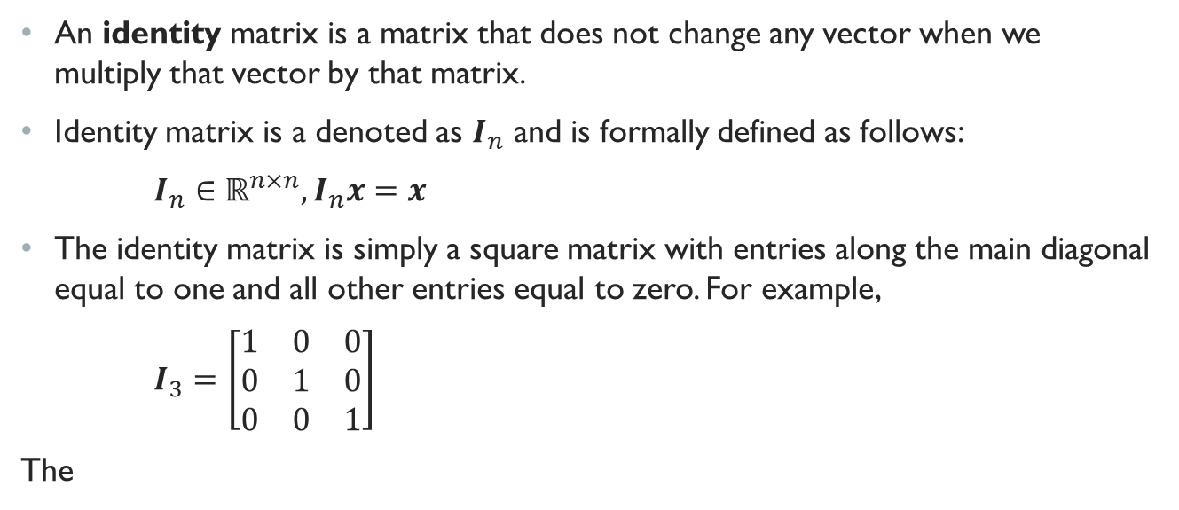
Identity Matrix
An identity matrix is a matrix that does not change any vector when we multiply that vector by that matrix.
Identity matrix is a denoted as $I_{n}$ and is formally defined as follows:
$I_{n}∈ℝ^{n×n}, I_{n}x=x$
The identity matrix is simply a square matrix with entries along the main diagonal equal to one and all other entries equal to zero. For example,
$I_{3}=\left[\begin{matrix}1 & 0 & 0 \\ 0 & 1 & 0 \\ 0 & 0 & 1\end{matrix}\right]$
The

Slide 42
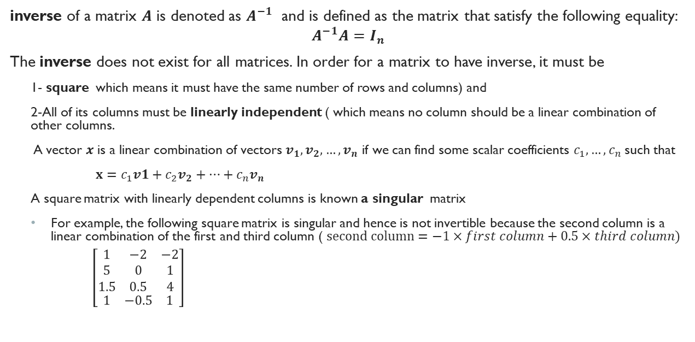
Inverse Matrices (Cont.)
inverse of a matrix $A$ is denoted as $A^{−1}$ and is defined as the matrix that satisfy the following equality:
$$A^{−1}A=I_{n}$$
The inverse does not exist for all matrices. In order for a matrix to have inverse, it must be
1- square which means it must have the same number of rows and columns) and
2-All of its columns must be linearly independent ( which means no column should be a linear combination of other columns.
A vector $x$ is a linear combination of vectors $v_{1},v_{2}, …,v_{n}$ if we can find some scalar coefficients $c_{1},…,c_{n}$such that
$x=c_{1}v1+c_{2}v_{2}+…+c_{n}v_{n}$
A square matrix with linearly dependent columns is known a singular matrix
For example, the following square matrix is singular and hence is not invertible because the second column is a linear combination of the first and third column ( $second column=−1×first column+0.5×third column)$
$\left[\begin{aligned}\begin{matrix}1 & −2 & −2 \\ 5 & 0 & 1 \\ 1.5 & 0.5 & 4\end{matrix} \\ \begin{matrix}1 & −0.5 & 1\end{matrix}\end{aligned}\right]$

Slide 43
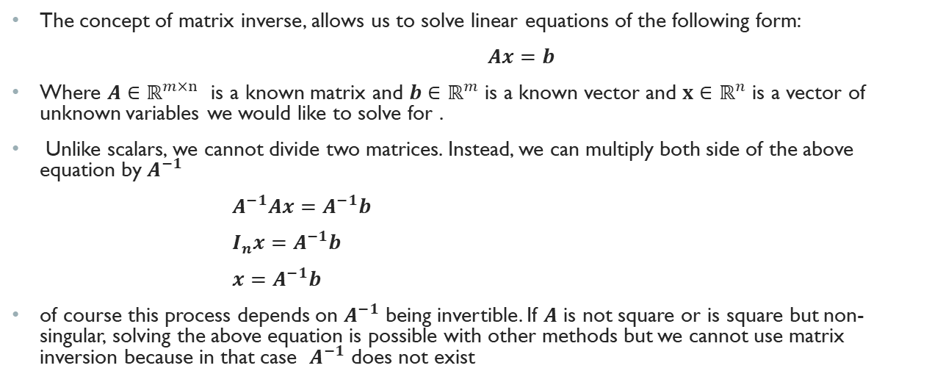
Where is matrix inverse used?
The concept of matrix inverse, allows us to solve linear equations of the following form:
$Ax=b$
Where $A∈ℝ^{m×n}$ is a known matrix and $b∈ℝ^{m}$ is a known vector and $x∈ℝ^{n}$ is a vector of unknown variables we would like to solve for .
Unlike scalars, we cannot divide two matrices. Instead, we can multiply both side of the above equation by $A^{−1}$
$A^{−1}Ax=A^{−1}b$
$I_{n}x=A^{−1}b$
$x=A^{−1}b$
of course this process depends on $A^{−1}$ being invertible. If $A$ is not square or is square but non-singular, solving the above equation is possible with other methods but we cannot use matrix inversion because in that case $A^{−1}$ does not exist

Slide 44
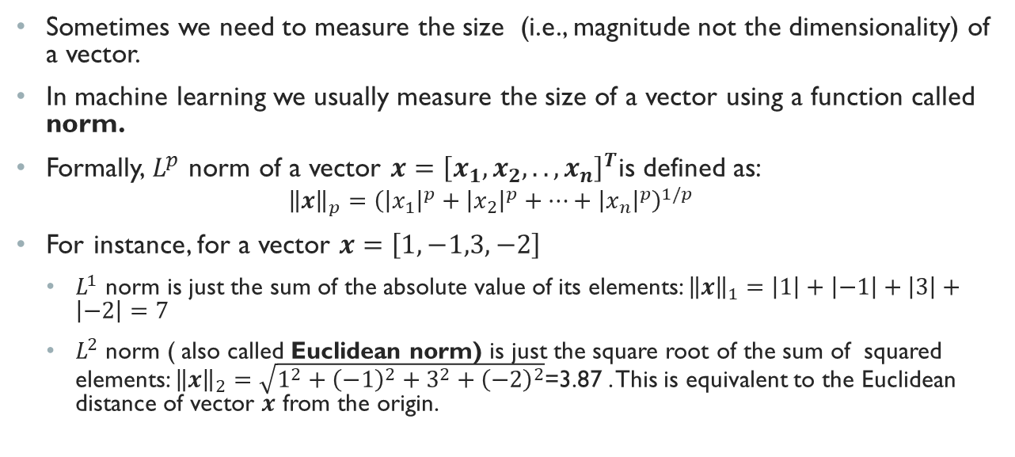
Vector Norm
Sometimes we need to measure the size (i.e., magnitude not the dimensionality) of a vector.
In machine learning we usually measure the size of a vector using a function called norm.
Formally, $L^{p}$ norm of a vector $x={\left[x_{1},x_{2},..,x_{n}\right]}^{T}$is defined as:
$${\left\|x\right\|}_{p}={\left({\left|x_{1}\right|}^{p}+{\left|x_{2}\right|}^{p}+…+{\left|x_{n}\right|}^{p}\right)}^{1/p}$$
For instance, for a vector $x=\left[1,−1,3,−2\right]$
$L^{1}$ norm is just the sum of the absolute value of its elements: ${\left\|x\right\|}_{1}=\left|1\right|+\left|−1\right|+\left|3\right|+\left|−2\right|=7$
$L^{2}$ norm ( also called Euclidean norm) is just the square root of the sum of squared elements: ${\left\|x\right\|}_{2}=\sqrt{1^{2}+{\left(−1\right)}^{2}+3^{2}+{\left(−2\right)}^{2}}$=3.87 . This is equivalent to the Euclidean distance of vector $x$ from the origin.

Slide 45
Preliminaries
1.1 AI vs ML vs Deep Learning
1.2 Elements of a Machine Learning Program
1.3 Examples of Machine Learning Programs
Background: Basic Linear Algebra
Linear Regression
Background: Probability
Logistic Regression
1.4 Capacity, Overfitting, and Under-fitting
1.5 Hyper-parameters and Validation Sets

Slide 46
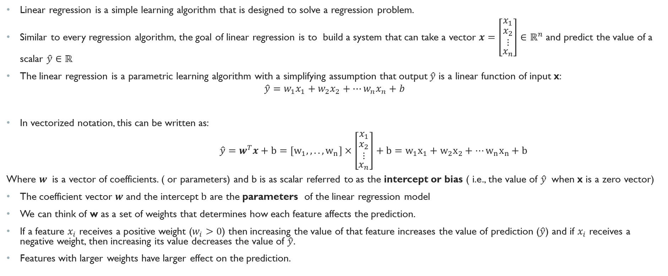
Linear Regression
Linear regression is a simple learning algorithm that is designed to solve a regression problem.
Similar to every regression algorithm, the goal of linear regression is to build a system that can take a vector $x=\left[\begin{matrix}x_{1} \\ \begin{aligned}x_{2} \\ ⋮\end{aligned} \\ x_{n}\end{matrix}\right]∈ℝ^{n}$ and predict the value of a scalar $\hat{y}∈ℝ$
The linear regression is a parametric learning algorithm with a simplifying assumption that output $\hat{y}$ is a linear function of input x:
$$\hat{y}=w_{1}x_{1}+w_{2}x_{2}+…w_{n}x_{n}+b$$
In vectorized notation, this can be written as:
$\hat{y}=w^{T}x+b=\left[w_{1},,..,w_{n}\right]×\left[\begin{matrix}x_{1} \\ \begin{aligned}x_{2} \\ ⋮\end{aligned} \\ x_{n}\end{matrix}\right]+b=w_{1}x_{1}+w_{2}x_{2}+…w_{n}x_{n}+b$
Where $w$ is a vector of coefficients. ( or parameters) and b is as scalar referred to as the intercept or bias ( i.e., the value of $\hat{y}$ when x is a zero vector)
The coefficient vector $w$ and the intercept $b$ are the parameters of the linear regression model
We can think of w as a set of weights that determines how each feature affects the prediction.
If a feature $x_{i}$ receives a positive weight ($w_{i}>0$) then increasing the value of that feature increases the value of prediction ($\hat{y}$) and if $x_{i}$ receives a negative weight, then increasing its value decreases the value of $\hat{y}$.
Features with larger weights have larger effect on the prediction.

Slide 47
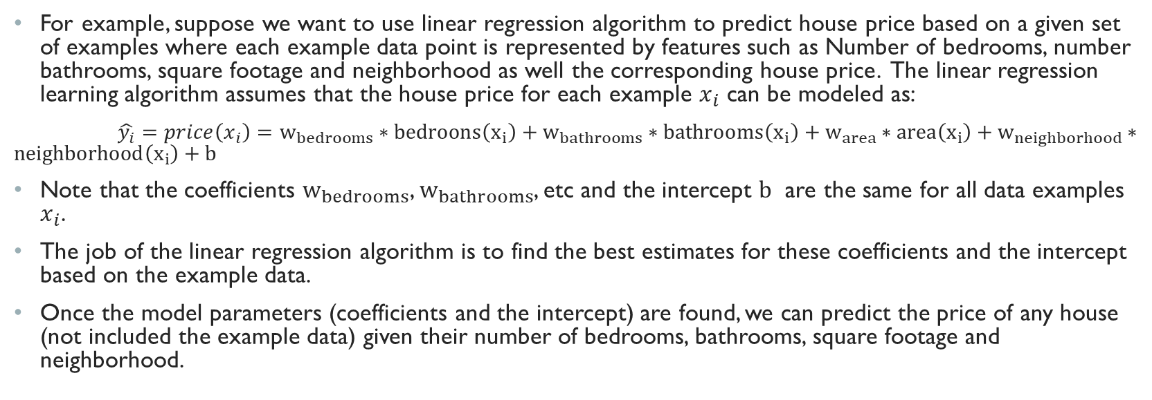
Linear Regression Example
For example, suppose we want to use linear regression algorithm to predict house price based on a given set of examples where each example data point is represented by features such as Number of bedrooms, number bathrooms, square footage and neighborhood as well the corresponding house price. The linear regression learning algorithm assumes that the house price for each example $x_{i}$ can be modeled as:
$\hat{y_{i}}=price\left(x_{i}\right)=w_{bedrooms}∗bedroons\left(x_{i}\right)+w_{bathrooms}∗bathrooms\left(x_{i}\right)+w_{area}∗area\left(x_{i}\right)+w_{neighborhood}∗neighborhood\left(x_{i}\right)+b$
Note that the coefficients $w_{bedrooms}$, $w_{bathrooms}$, etc and the intercept $b$ are the same for all data examples $x_{i}$.
The job of the linear regression algorithm is to find the best estimates for these coefficients and the intercept based on the example data.
Once the model parameters (coefficients and the intercept) are found, we can predict the price of any house (not included the example data) given their number of bedrooms, bathrooms, square footage and neighborhood.

Slide 48
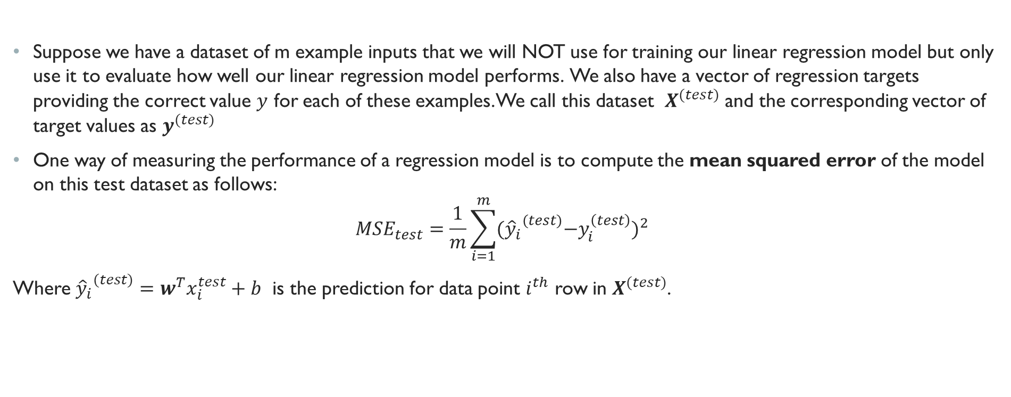
Learning Algorithm: Performance Measure
Suppose we have a dataset of m example inputs that we will NOT use for training our linear regression model but only use it to evaluate how well our linear regression model performs. We also have a vector of regression targets providing the correct value $y$ for each of these examples. We call this dataset $X^{(test)}$ and the corresponding vector of target values as $y^{(test)}$
One way of measuring the performance of a regression model is to compute the mean squared error of the model on this test dataset as follows:
$$MSE_{test}=\frac{1}{m}\sum_{i=1}^{m}{{{({\hat{y}}_{i}}^{(test)}−y_{i}^{\left(test\right)})}^{2} }$$
Where ${{\hat{y}}_{i}}^{(test)}=w^{T}x_{i}^{test}+b$ is the prediction for data point $i^{th}$ row in $X^{(test)}$.

Slide 49
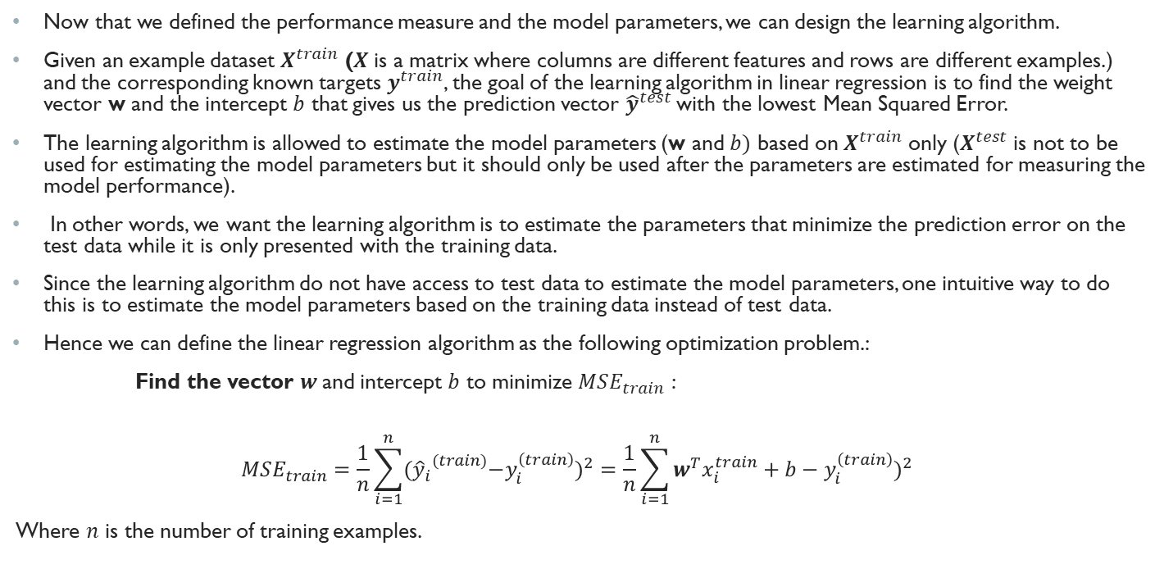
Linear Regression: Estimating Model Parameters
Now that we defined the performance measure and the model parameters, we can design the learning algorithm.
Given an example dataset $X^{train}$ ($X$is a matrix where columns are different features and rows are different examples.) and the corresponding known targets $y^{train}$, the goal of the learning algorithm in linear regression is to find the weight vector w and the intercept $b$ that gives us the prediction vector ${\hat{y}}^{test}$ with the lowest Mean Squared Error.
The learning algorithm is allowed to estimate the model parameters (w and $b)$ based on $X^{train}$ only ($X^{test}$ is not to be used for estimating the model parameters but it should only be used after the parameters are estimated for measuring the model performance).
In other words, we want the learning algorithm is to estimate the parameters that minimize the prediction error on the test data while it is only presented with the training data.
Since the learning algorithm do not have access to test data to estimate the model parameters, one intuitive way to do this is to estimate the model parameters based on the training data instead of test data.
Hence we can define the linear regression algorithm as the following optimization problem.:
Find the vector $w$and intercept $b$ to minimize $MSE_{train}$ :
$$MSE_{train}=\frac{1}{n}\sum_{i=1}^{n}{{{({\hat{y}}_{i}}^{(train)}−y_{i}^{\left(train\right)})}^{2}=\frac{1}{n}\sum_{i=1}^{n}{{w^{T}x_{i}^{train}+b−y_{i}^{\left(train\right)})}^{2} }}$$
Where $n$ is the number of training examples.

Slide 50
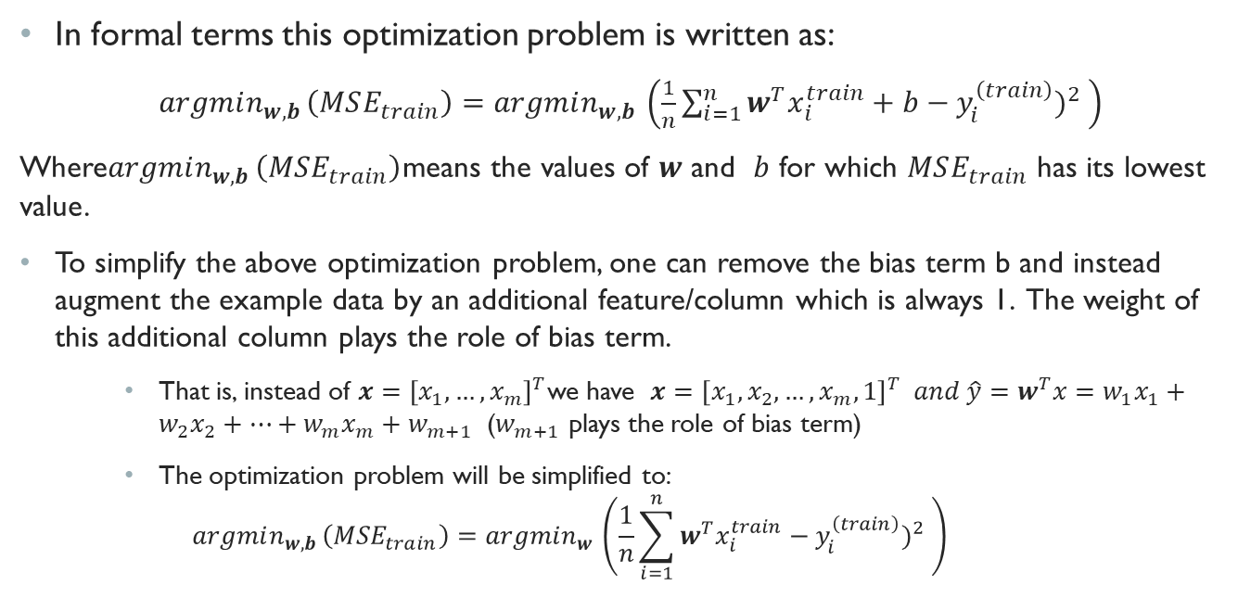
Linear Regression: Estimating Model Parameters (Cont.)
In formal terms this optimization problem is written as:
$argmin_{w,b }\left(MSE_{train}\right)=argmin_{w,b }\left(\frac{1}{n}\sum_{i=1}^{n}{{w^{T}x_{i}^{train}+b−y_{i}^{\left(train\right)})}^{2} }\right)$
Where$argmin_{w,b }\left(MSE_{train}\right)$means the values of $w$ and $b$ for which $MSE_{train}$ has its lowest value.
To simplify the above optimization problem, one can remove the bias term b and instead augment the example data by an additional feature/column which is always 1. The weight of this additional column plays the role of bias term.
That is, instead of $x={\left[x_{1},…,x_{m}\right]}^{T}$we have $x={\left[x_{1},x_{2},…,x_{m},1\right]}^{T} and \hat{y}=w^{T}x=w_{1}x_{1}+w_{2}x_{2}+…+w_{m}x_{m}+w_{m+1}$ ($w_{m+1}$ plays the role of bias term)
The optimization problem will be simplified to:
$$argmin_{w,b }\left(MSE_{train}\right)=argmin_{w }\left(\frac{1}{n}\sum_{i=1}^{n}{{w^{T}x_{i}^{train}−y_{i}^{\left(train\right)})}^{2} }\right)$$

Slide 51
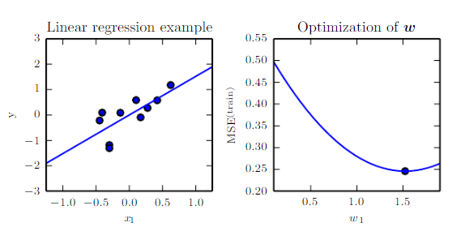
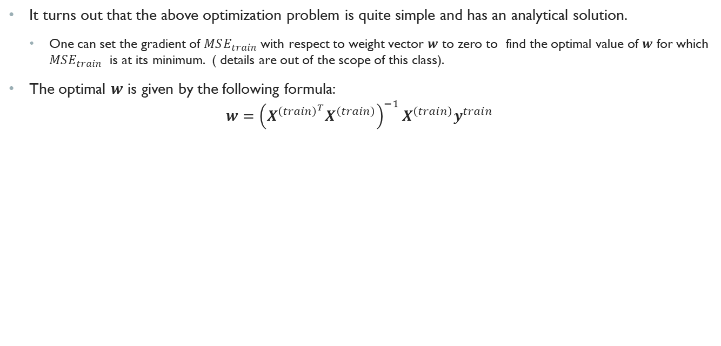
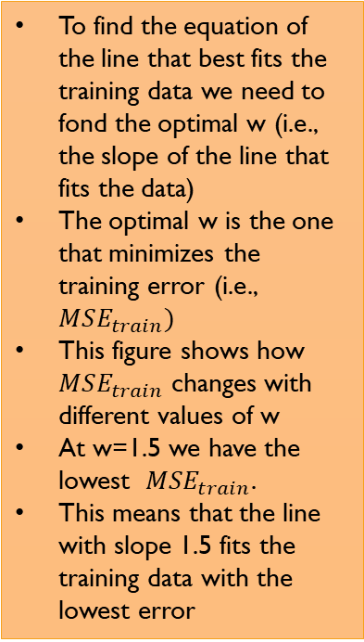
Linear Regression: Estimating Model Parameters (Cont.)
It turns out that the above optimization problem is quite simple and has an analytical solution.
One can set the gradient of $MSE_{train}$ with respect to weight vector $w$ to zero to find the optimal value of $w$ for which $MSE_{train}$ is at its minimum. ( details are out of the scope of this class).
The optimal $w$ is given by the following formula:
$$w={\left(X^{{\left(train\right)}^{T}}X^{\left(train\right)}\right)}^{−1}X^{\left(train\right)}y^{train}$$
To find the equation of the line that best fits the training data we need to fond the optimal w (i.e., the slope of the line that fits the data)
The optimal w is the one that minimizes the training error (i.e., $MSE_{train})$
This figure shows how $MSE_{train}$ changes with different values of w
At w=1.5 we have the lowest $MSE_{train}$.
This means that the line with slope 1.5 fits the training data with the lowest error
Here is an example of linear regression with only one feature.
We have a training set of 5 data points. (the blue dots) The x-axis show the value of the feature and the y-axis show the target.
The goal of linear regression is to find the equation of a line that can best fit these data points and capture their trend

Slide 52
Preliminaries
1.1 AI vs ML vs Deep Learning
1.2 Elements of a Machine Learning Program
1.3 Examples of Machine Learning Programs
Background: Basic Linear Algebra
Linear Regression
Background: Probability
Logistic Regression
1.4 Capacity, Overfitting, and Under-fitting
1.5 Hyper-parameters and Validation Sets

Slide 53
Basic Probability Refresher
The most simple form of a deep learning model is a stack of logistic regression units.
Therefore it makes sense to review logistic regression model as another example of a machine learning program.
However, before doing so, we need a quick refresher on probability.
In one form or another machine learning is all about making predictions. In many cases, not only we need the machines to make predictions based on the example data but we also want to know how confident the machine is in those predictions.
For instance, consider a classification algorithm that takes a mammogram image and predicts whether a tumor present in the image is malignant or benign . If the classification algorithm decides that the tumor is malignant with 98% confidence in one image and only 55% confidence in another image, then it might be recommended to proceed with further diagnostic tests (such as core needle biopsy) in the former case.
Many classification algorithms such as logistic regression and classification neural networks provide a probability value for each class of the target variable measuring their confidence in predicting that class.
So let’s do a quick review of some of the basic probability concepts we need in this class.

Slide 54
What is probability
Everybody is familiar with the phrase “the probability that a coin will land heads is 0.5”. But what does this exactly mean?
Loosely speaking, probability is the chance of an event occurring.
There are two interpretations of probability:
Frequentist Interpretation: probabilities represent long run frequencies of events. For example, if we flip the coin many times, we expect it to land heads about half the time so the probability of a fair coin landing on head is 0.5
Bayesian Interpretation: probability is used to quantify our uncertainty about something; hence it is fundamentally related to information rather than repeated trials. We know that the a fair coin is equally likely to land heads or tail, therefore, we know that the probability of landing head is 0.5 ( without having to repeatedly toss the coin)

Slide 55
Random experiments, outcome, and sample space
A random experiment is an experiment or a process for which the outcome cannot be predicted with certainty
For instance rolling a die is a random experiment because you don’t know what number you will see
An outcome is the result of a single trial of a random experiment.
For example, seeing a number between 1-6 is an outcome of rolling a die.
Sample Space: is a set of all possible outcomes or a random experiment
For instance, the sample space for tossing a coin is {Head, Tail}, the sample space for rolling a die is {1,2,3,4,5,6}. The sample space of tossing two coins is {Head-Head, Tail-Head, Head-Tail, Tail-Tail}
Event: is a subset of a sample space.
For instance, the event of seeing an odd number when rolling a die is {1,3} or the event of getting a sum greater than 12 when rolling two dice is empty {}.

Slide 56
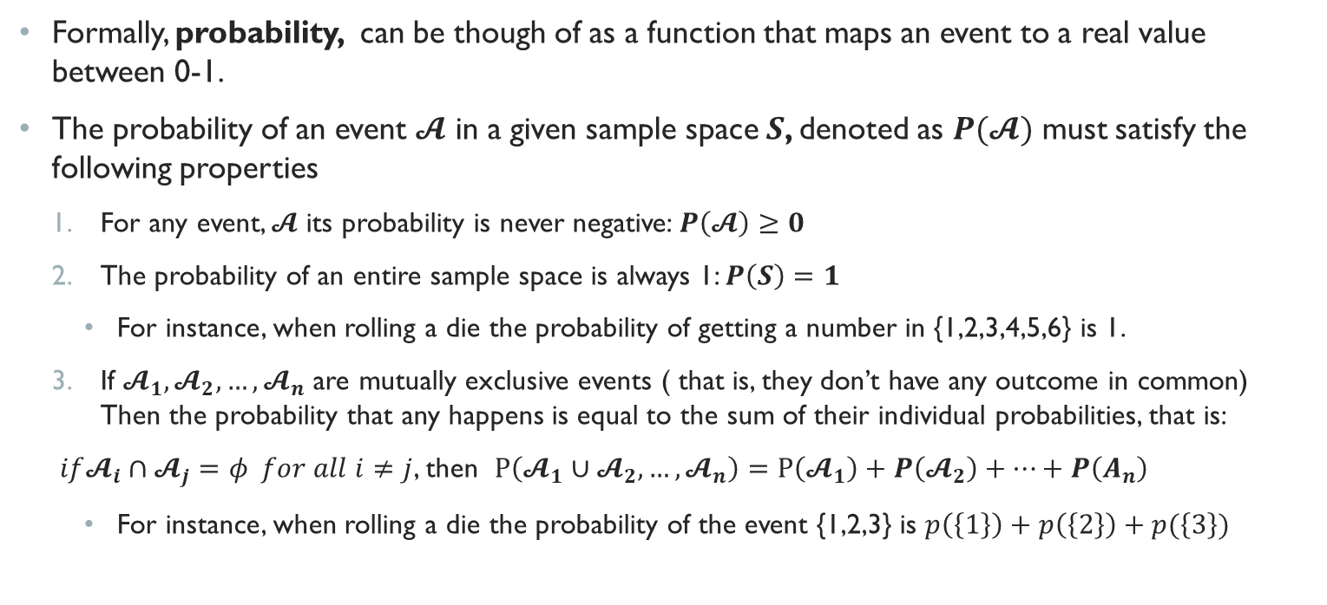
Axioms of Probability
Formally, probability, can be though of as a function that maps an event to a real value between 0-1.
The probability of an event $𝓐$ in a given sample space $S$, denoted as $P(𝓐)$ must satisfy the following properties
For any event, $𝓐$ its probability is never negative: $P\left(𝓐\right)≥0$
The probability of an entire sample space is always 1: $P\left(S\right)=1$
For instance, when rolling a die the probability of getting a number in {1,2,3,4,5,6} is 1.
If $𝓐_{1},𝓐_{2},…,𝓐_{n}$ are mutually exclusive events ( that is, they don’t have any outcome in common) Then the probability that any happens is equal to the sum of their individual probabilities, that is:
$if𝓐_{i}∩𝓐_{j}=φ for all i≠j$, then $P\left(𝓐_{1}∪𝓐_{2},…,𝓐_{n}\right)=P\left(𝓐_{1}\right)+P\left(𝓐_{2}\right)+…+P\left(A_{n}\right)$
For instance, when rolling a die the probability of the event {1,2,3} is $p\left(\left\{1\right\}\right)+p\left(\left\{2\right\}\right)+p(\left\{3\right\})$

Slide 57
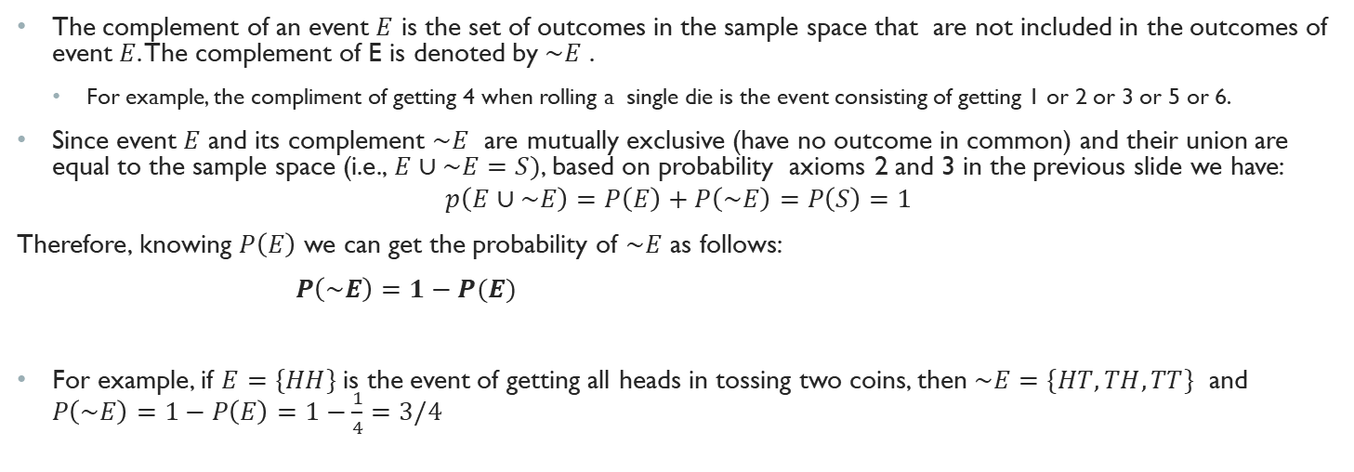
Complement of an Event
The complement of an event $E$ is the set of outcomes in the sample space that are not included in the outcomes of event $E$. The complement of E is denoted by $\sim E$ .
For example, the compliment of getting 4 when rolling a single die is the event consisting of getting 1 or 2 or 3 or 5 or 6.
Since event $E$ and its complement $\sim E$ are mutually exclusive (have no outcome in common) and their union are equal to the sample space (i.e., $E∪\sim E=S)$, based on probability axioms 2 and 3 in the previous slide we have:
$$p\left(E∪\sim E\right)=P\left(E\right)+P\left(\sim E\right)=P\left(S\right)=1$$
Therefore, knowing $P\left(E\right)$ we can get the probability of $\sim E$ as follows:
$P\left(\sim E\right)=1−P(E)$
For example, if $E=\{HH\}$ is the event of getting all heads in tossing two coins, then $\sim E=\{HT,TH,TT\}$ and $P\left(\sim E\right)=1−P\left(E\right)=1−\frac{1}{4}=3/4$

Slide 58
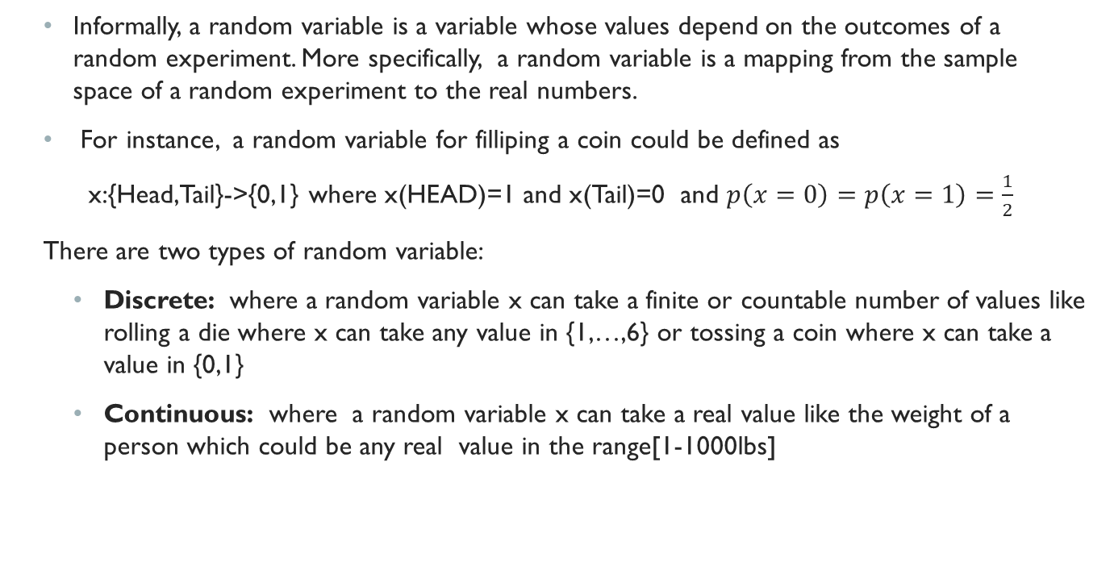
Random Variable
Informally, a random variable is a variable whose values depend on the outcomes of a random experiment. More specifically, a random variable is a mapping from the sample space of a random experiment to the real numbers.
For instance, a random variable for filliping a coin could be defined as
x:{Head,Tail}->{0,1} where x(HEAD)=1 and x(Tail)=0 and $p\left(x=0\right)=p\left(x=1\right)=\frac{1}{2}$
There are two types of random variable:
Discrete: where a random variable x can take a finite or countable number of values like rolling a die where x can take any value in {1,…,6} or tossing a coin where x can take a value in {0,1}
Continuous: where a random variable x can take a real value like the weight of a person which could be any real value in the range[1-1000lbs]

Slide 59
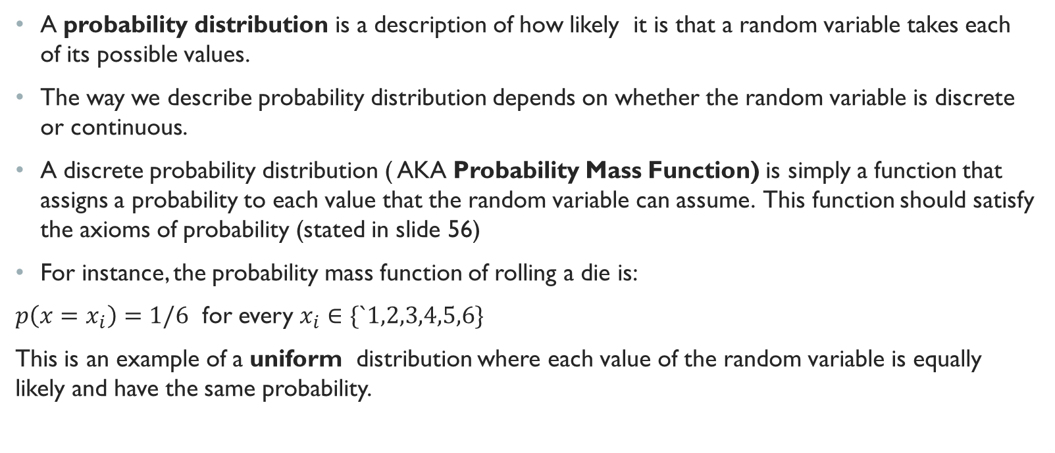
Probability Distribution
A probability distribution is a description of how likely it is that a random variable takes each of its possible values.
The way we describe probability distribution depends on whether the random variable is discrete or continuous.
A discrete probability distribution ( AKA Probability Mass Function) is simply a function that assigns a probability to each value that the random variable can assume. This function should satisfy the axioms of probability (stated in slide 56)
For instance, the probability mass function of rolling a die is:
$p\left(x=x_{i}\right)=1/6$ for every $x_{i}∈\{`1,2,3,4,5,6\}$
This is an example of a uniform distribution where each value of the random variable is equally likely and have the same probability.

Slide 60
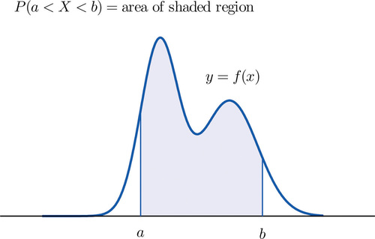
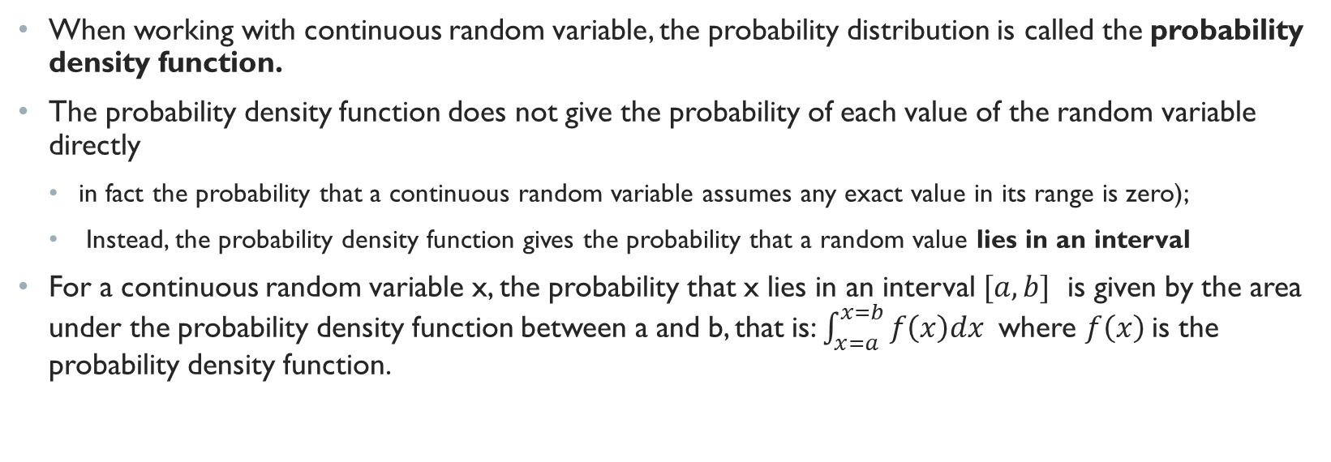
Continuous variables and probability density function
When working with continuous random variable, the probability distribution is called the probability density function.
The probability density function does not give the probability of each value of the random variable directly
in fact the probability that a continuous random variable assumes any exact value in its range is zero);
Instead, the probability density function gives the probability that a random value lies in an interval
For a continuous random variable x, the probability that x lies in an interval $[a,b]$ is given by the area under the probability density function between a and b, that is: $\int_{x=a}^{x=b}{f\left(x\right)dx}$ where $f\left(x\right)$is the probability density function.
Image source: here

Slide 61
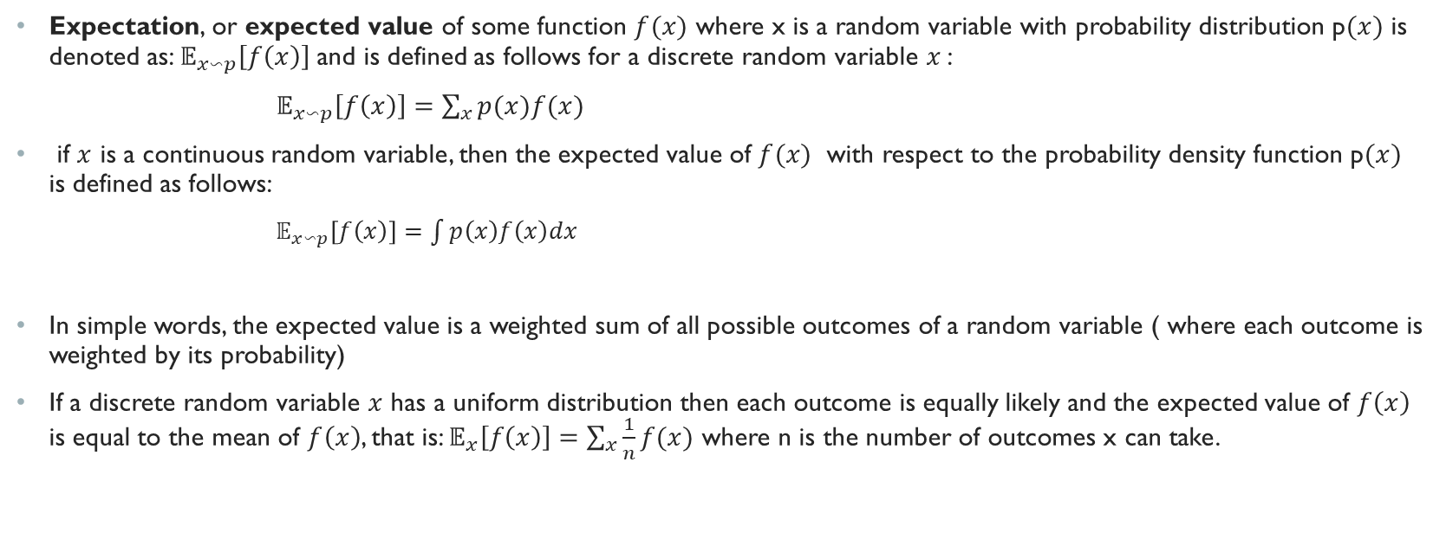
Expectation
Expectation, or expected value of some function $f(x)$ where x is a random variable with probability distribution p$(x)$ is denoted as: $𝔼_{x∽p}\left[f\left(x\right)\right]$ and is defined as follows for a discrete random variable $x$:
$𝔼_{x∽p}\left[f\left(x\right)\right]=\sum_{x}{p(x)f(x)}$
if $x$ is a continuous random variable, then the expected value of $f(x)$ with respect to the probability density function p$(x)$ is defined as follows:
$𝔼_{x∽p}\left[f\left(x\right)\right]=\int{p\left(x\right)f\left(x\right)dx}$
In simple words, the expected value is a weighted sum of all possible outcomes of a random variable ( where each outcome is weighted by its probability)
If a discrete random variable $x$ has a uniform distribution then each outcome is equally likely and the expected value of $f\left(x\right)$ is equal to the mean of $f\left(x\right)$, that is: $𝔼_{x}\left[f\left(x\right)\right]=\sum_{x}{\frac{1}{n}f(x)}$ where n is the number of outcomes x can take.

Slide 62
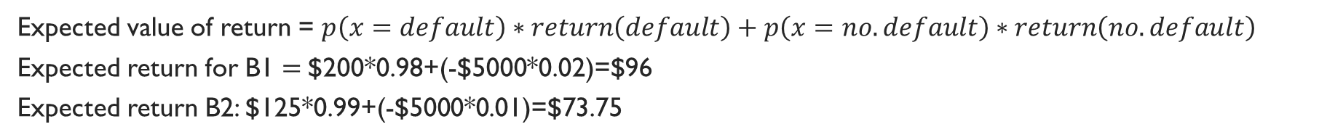
Expectation Example
One application of expected value is in decision making where you have to choose between several alternatives with uncertain outcomes.
A financial adviser suggests that you select one of two types of bonds in which to invest $5000. Bond B1 pays a return of 4% and has a default rate of 2%. Bond B2 has a return 2.5% and a default rate of 1%. Which bond is a better investment on average?
To answer the question, I can define the random variable x with two outcomes {default, no-default) and then compute the expected value of return for each bond.
 | Bond B1
Random Variable X | 4%*$5000=$ 200 (no default) | -$5000 (default)
P(x) | 0.98 | 0.02
 | Bond B2
Random Variable X= Return | 2.5%*$5000= $125 (no default) | -$5000 (default)
P(x) | 0.99 | 0.01
Expected value of return = $p\left(x=default\right)∗return\left(default\right)+p\left(x=no.default\right)∗return\left(no.default\right)$
Expected return for B1 $=$$200*0.98+(-$5000*0.02)=$96
Expected return B2: $125*0.99+(-$5000*0.01)=$73.75

Slide 63
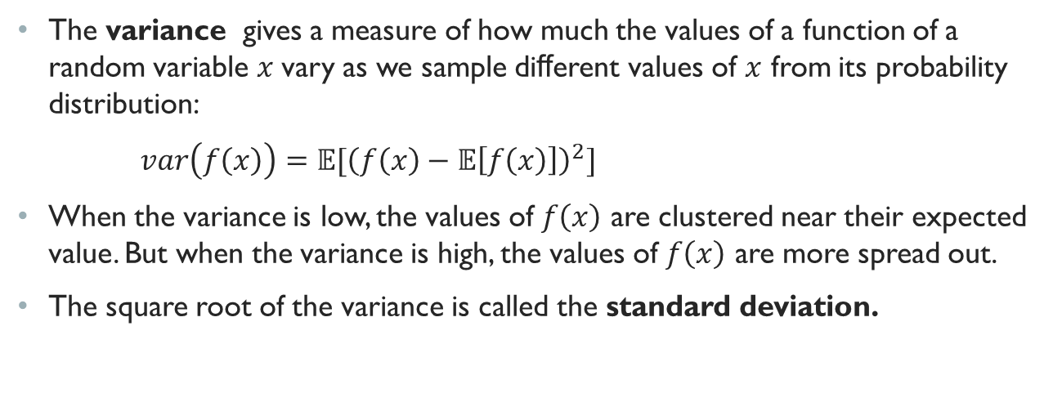
Variance
The variance gives a measure of how much the values of a function of a random variable $x$vary as we sample diﬀerent values of $x$ from its probability distribution:
$var\left(f\left(x\right)\right)=𝔼[{\left(f\left(x\right)−𝔼\left[f\left(x\right)\right]\right)}^{2}]$
When the variance is low, the values of $f\left(x\right)$ are clustered near their expected value. But when the variance is high, the values of $f\left(x\right)$ are more spread out.
The square root of the variance is called the standard deviation.

Slide 64
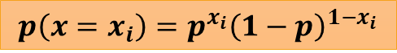
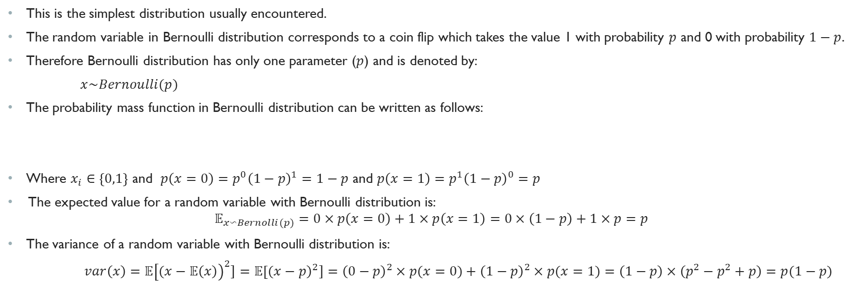
Bernoulli: An Example of Discrete Probability Distribution
This is the simplest distribution usually encountered.
The random variable in Bernoulli distribution corresponds to a coin flip which takes the value 1 with probability $p$ and 0 with probability $1−p.$
Therefore Bernoulli distribution has only one parameter ($p$) and is denoted by:
$x\sim Bernoulli(p)$
The probability mass function in Bernoulli distribution can be written as follows:
Where $x_{i}∈\left\{0,1\right\}$ and $p\left(x=0\right)=p^{0}{\left(1−p\right)}^{1}=1−p$ and $p\left(x=1\right)=p^{1}{\left(1−p\right)}^{0}=p$
The expected value for a random variable with Bernoulli distribution is:
$$𝔼_{x∽Bernolli(p)}=0×p\left(x=0\right)+1×p\left(x=1\right)=0×\left(1−p\right)+1×p=p$$
The variance of a random variable with Bernoulli distribution is:
$var\left(x\right)=𝔼{\left[(x−𝔼\left(x\right)\right)}^{2}]=𝔼{\left[(x−p\right)}^{2}]={\left(0−p\right)}^{2}×p(x=0)+{\left(1−p\right)}^{2}×p(x=1)=\left(1−p\right)×\left(p^{2}−p^{2}+p\right)=p(1−p)$
$$p\left(x=x_{i}\right)=p^{x_{i}}{\left(1−p\right)}^{1−x_{i}}$$

Slide 65

Gaussian: An example of Continuous probability Distribution
The most commonly used continuous probability distribution is the normal distribution also known as Gaussian distribution.
Normal distribution is characterized by two parameters $μ$ (which is also the mean or expected value of the distribution) and $σ$ which is the standard deviation of the distribution ($σ^{2}$ is the variance). The probability density function of normal distribution is as follows:
$𝒩\left(x:,μ,σ^{2}\right)=\sqrt{\frac{1}{2πσ^{2}}} exp⁡(−\frac{1}{2σ^{2}}{\left(x−μ\right)}^{2})$
Normal distributions are a sensible choice for many applications.
In the absence of prior knowledge about what form a distribution over the real numbers should take, the normal distribution is a good default choice

Slide 66



Gaussian Distribution (Cont.)
The normal distribution is bell-shaped and symmetric around the mean.
The parameter $μ$ (mean) shows the position of the center of the bell curve and the parameter $σ$(standard deviation) shows the spread of the curve around the mean.
The figure shows two normal distributions
With different parameters $μ$ and $σ$

Slide 67
Dealing with multiple random variables
Very often we want to consider more than one random variable at a time.
For instance, we want to model the relationship between disease and a symptom. For instance, given a particular symptom such as cough or shortness of breath, we want to know the probability of flu or COVID19.
In what follows, we will talk about some of the terminologies that concern multiple random variables.

Slide 68

Joint and Conditional Probability
The join probability is simply a probability of two events occurring simultaneously.
The joint probability that random variable x=a and random variable y=b simultaneously is denoted as $p(x=a,y=b)$
Note that $p\left(x=a,y=b\right)≤p\left(x=a\right)$ and $p\left(x=a,y=b\right)≤p\left(y=b\right)$
This makes sense because the chance that both $x=a and y=b$ to happen is less than the chance that $x=a$happened and y$=b$happen individually
For instance, the probability of picking a card that is both Ace and black from a deck of 52 cards is: p(card=Ace, color=Black)=2/52 which is less than p(card=Ace)=4/52 and p(card=black)=26/52
The conditional probability is the probability of an event occurring knowing that another event has already occurred.
The conditional probability that $x=a$ given $y=b$ is denoted as $p(x=a|y=b)$ and is computed with the following formula:
$$p\left(x=a | y=b\right)=\frac{p\left(x=a,y=b\right)}{p\left(y=b\right)}$$
For example, the probability that you get an Ace given that you drew a black card is:
$$p\left(card=Ace | color=Black\right)=\frac{2}{26}=\frac{\left(card=Ace | color=Black\right)}{p\left(color=Black\right)}=\frac{\frac{2}{52}}{\frac{26}{52}}$$

Slide 69

Marginal probability
Sometimes, we have the joint probability of some random variables and we are interested to know the probability distribution of over just a subset of them. This is called marginalization or marginal probability.
For instance, suppose we have the join probability distribution $p(x,y)$ over the discrete random variables $x and y$but we are interested to get $p(x$). We can compute $p(x=x_{i}$) for each $x_{i}∈x$ as follows:
$p\left(x=x_{i}\right)=\sum_{y_{j}}{p(x=x_{i}, y=y_{j})}$
This is known as sum rule because we are summing the joint probability over all values of the random variable $y$.
For instance, in a family of two children, what is the probability that the first child is a girl?
p$\left(first=G\right)=p\left(first=G,second=B\right)+p\left(first=G,second=G\right)=\frac{1}{4}+\frac{1}{4}=1/2$
If $x and y$ are continuous random variable, then we need to use integration instead of summation in the sum rule.
$$p\left(x\right)=\int{p\left(x,y\right)dy}$$

Slide 70

Independence
Two random variables $x$ and $y$ are independent if occurrence of an event of $x$ does not reveal any information about the occurrence of an event of $y$.
Formally, two random variables are $x$ and $y$ are independent if their joint probability is equal to the product of the individual probabilities:
$$for each x_{i}∈x and y_{j}∈y P\left(x=x_{i}, y=y_{j}\right)=p\left(x=x_{i}\right)×p(y=y_{j})$$
From the definition of the conditional probability it follows that for two independent random variables $x$ and $y$
$p\left(x=x_{i} | y=y_{i}\right)=\frac{p\left(x=x_{i},y=y_{i}\right)}{p\left(y=y_{i}\right)}=\frac{p\left(x=x_{i}\right)×p\left(y=y_{i}\right)}{p\left(y=y_{i}\right)}=p\left(x=x_{i}\right)$
In a similar way, for two independent random variables $x$ and $y$ we have:$p\left(y=y_{j} | x=x_{i}\right)=p\left(y=y_{j}\right)$
For instance, the probability of a second die landing on odd does not depend on the number that the first die landed on
but the probability that a second card drawn from a deck of card is king depends on the first card that was drawn. If the first card drawn was a king, then the probability of the second card being also a king is p(second=king | first=king)=3/51. Otherwise, if the first card was not the king, this probability is p(second=king|first$≠$king)=4/51

Slide 71

Conditional Independence
Two random variables $x$ and $y$ are conditionally independent given another random variable $z$ if for every $x_{i}∈x , y_{j}∈y and z_{k}∈z$, we have:
$$P\left(x=x_{i}, y=y_{j}|z=z_{k}\right)=p\left(x=x_{i}|z=z_{k}\right)×p(y=y_{j}|z=z_{k})$$
Example: A box contains two coins: a regular coin and one fake two-headed coin (P(H)=1). I choose a coin at random and toss it twice. What is the probability that I get head in both first and second coin toss?
(suppose H is the event that a coin toss results in head, $F$ is the event that the fake coin is selected and $\sim F$ is the event that the regular coin is selected).
$p\left(H,H\right)=P\left(H,H,F\right)+P\left(H,H,\sim F\right)$ (based on marginal probability)
$=p\left(H,H | F\right)P\left(F\right)+P\left(H,H | \sim F\right)P\left(\sim F\right)$ (based on definition of conditional probability)
$=p\left(H | F\right)P(H|F)P\left(F\right)+P\left(H | \sim F\right)P\left(H | \sim F\right)P\left(\sim F\right)$ (based on the conditional independence)
$$=1×1×\frac{1}{2}+\frac{1}{2}×\frac{1}{2}×\frac{1}{2}=\frac{5}{8}$$

Slide 72


Bayes Rule
We often find ourselves in a situation where we know $p(x|y)$ and need to know $p(y|x)$
Using the definition of conditional probabilities, we can derive one of the most useful and celebrated equations in statistics: Bayes’ theorem
By definition of conditional probability, we know that $p\left(x,y\right)=p\left(x | y\right)∗p(y)$ by symmetry, this is equal to $p\left(y | x\right)∗p(x)$.
$p\left(y | x\right)×p\left(x\right)=p\left(x | y\right)×p\left(y\right)=p(x,y)$
Therefore, we can derive the following formula known as Bayes rule:
$$p\left(y | x\right)=\frac{p\left(x | y\right)∗p\left(y\right)}{p\left(x\right)}$$

Slide 73

Example Application of Bayes Rule
Assume that a doctor administers an HIV test to a patient.
This test is fairly accurate and it fails only with 1% probability if the patient is healthy but reporting him as diseased. This means the false positive rate or $p\left(Positive | \sim Disease\right)=0.01$ which is equivalent to $p\left(Negative | \sim Disease\right)=0.99$
The test never fails to detect HIV if the patient actually has it. This means that the false negative rate is 0% or $p\left(Negative | Disease\right)=0$ which is equivalent to $p\left(Positive | Disease\right)=1$
Further assume that the population is quite healthy, for example, 15 out of every 10000 people have HIV, that is: $p\left(Disease\right)=0.0015$
What is the probability that a patient having HIV if his/her test comes back positive? $p\left(Disease | Positive\right)=?$

Slide 74

Example Application of Bayes Rule
Based on Bayes rule:
$$p\left(Disease | Positive\right)=\frac{p\left(Positive | Disease\right)×P\left(Disease\right)}{p\left(Positive\right)}$$
We know that $p\left(Positive | Disease\right)$=1 and $p\left(Disease\right)=0.0015$
We can compute $P\left(Positive\right)$ based on marginal probability rule:
$$P\left(Positive\right)=p\left(Positive,Disease\right)+p\left(Positive,\sim Disease\right)$$
$=p\left(Positive | Disease\right)×p\left(Disease\right)+p\left(Positive | ,\sim Disease\right)×p\left(\sim Disease\right)$
$=1×0.0015+0.01×\left(1−0.0015\right)=$0.011485
Now we can just plug $p\left(Positive\right)$ in to Bayes rule and we get
$$p\left(Disease | Positive\right)=\frac{1×0.0015}{0.011485}=0.1306$$

Slide 75

Maximum Likelihood Estimation
Maximum likelihood estimation (MLE) is a statistical technique that allows us to estimate the parameters of a given distribution, using some observed data.
For instance, suppose that we know that the height of adult men follow a normal distribution with unknown parameters ( that is, unknown $μ$ and $σ)$ .MLE can be used to estimate these parameters based on a limited sample of height of adult men.
Suppose that we have a set of m independent and identifiably distributed training examples $X=\left\{x^{ \left(1\right)}, x^{\left(2\right)},…x^{\left(n\right)}\right\}$ drawn from a true but unknown distribution $p_{data}\left(x\right).$
Let $p_{model}\left(θ\right)$ be a family of probability distributions with parameters $θ$ and we want to use $p_{model}\left(θ\right)$ to estimate the true distribution $p_{data}\left(x\right).$
The goal of MLE is to find the best estimate for $θ$ such that the probability $p_{model}\left(X;θ\right)$ is maximized.
In other words, MLE tries to answer this question: which values of $θ$ maximize the likelihood of observing the data we observed (i.e. observing X)?
$p_{model}\left(X;θ\right)$ is called the likelihood .. Since $x^{ \left(1\right)}, x^{\left(2\right)},…x^{\left(m\right)}$ are independent,, we have:
$L=p_{model}\left(X;θ\right)=p_{model}(x^{ \left(1\right)}, x^{\left(2\right)},…x^{\left(n\right)};θ)=p_{model}(x^{\left(1\right)};θ)×p_{model}(x^{\left(2\right)};θ)×…×p_{model}(x^{\left(n\right)};θ)$

Slide 76

Maximum Likelihood estimation (Cont.)
The goal of the MLE is to find the optimal $θ$ (denoted as $θ^{∗}$) that maximize the likelihood function. This can be formally stated as the following optimization problem:
$θ^{∗}=argmax_{θ}(p_{model}(x^{\left(1\right)};θ)×p_{model}(x^{\left(2\right)};θ)×…×p_{model}(x^{\left(n\right)};θ)$)
The product of many probabilities in the likelihood function is inconvenient and is subject to numerical underflow
that is, the result of multiplying many probabilities could be a smaller in magnitude than the smallest number that can be represented by a computer)
To obtain a more convenient but equivalent optimization problem, we typically take the log of likelihood function to convert the product of probabilities into sum of probabilities, that is:
$θ^{∗}=argmax_{θ } log(p_{model}(x^{\left(1\right)};θ)×p_{model}(x^{\left(2\right)};θ)×…×p_{model}(x^{\left(n\right)};θ$))
(from calculus we know that (log ab = log a + log b), hence,
$$θ^{∗}={argmax}_{θ}\log\left(p_{model}\left(x^{\left(1\right)};θ\right)\right)+\log\left(p_{model}\left(x^{\left(2\right)};θ\right)\right)+…+log⁡(p_{model}(x^{\left(n\right)};θ\text{)}\text{)}$$
Note that taking the log does not affect the value of $θ^{∗}$because the argmax of a function is the same as the argmax of the log of the function. This means that taking the log of a function does not affect the point at which the function is maximized.

Slide 77

MLE and supervised learning
The MLE estimator can be generalized to the case where our goal is to estimate a conditional probability distribution $p(y|X;θ)$
This forms the basis for estimating the parameters of a parametric supervised machine learning model where we have a set of training examples, $X$ ,and we want to estimate the parameters $θ$ which maximize the likelihood of observing the target $y$ given a set of features $X$.
$$θ^{∗}={argmax}_{θ}\log\left(p_{model}\left(y^{(1)}| x^{\left(1\right)};θ\right)\right)+\log\left(p_{model}\left({y^{(2)}|x}^{\left(2\right)};θ\right)\right)+…+\log\left(p_{model}\left({y^{\left(n\right)}|x}^{\left(n\right)};θ\right)\right)=argmax_{θ}\sum_{i}{\log\left(p_{model}\left({y^{(i)}|x}^{\left(i\right)};θ\right)\right)}$$
Where $y^{(i)}is the$target value, $x^{\left(i\right)}$is the vector feature for the ith example in the training data and $θ^{∗}$ is the optimal parameters which maximize the log likelihood.
We will see an example of this when we talk about estimating the parameters of the logistic regression model.

Slide 78
Preliminaries
1.1 AI vs ML vs Deep Learning
1.2 Elements of a Machine Learning Program
1.3 Examples of Machine Learning Programs
Background: Basic Linear Algebra
Linear Regression
Background: Probability
Logistic and softmax Regression
1.4 Capacity, Overfitting, and Under-fitting
1.5 Hyper-parameters and Validation Sets

Slide 79

Logistic Regression
Logistic regression is a classification learning algorithm (despite being called regression)
Similar to every classification learning algorithm, the goal of logistic regression is to build a model that can take a vector $x={\left[x_{1},x_{2},..,x_{n}\right]}^{T}∈ℝ^{n}$ and predict the value of a scalar $\hat{y}∈\{1,..k\}$ representing one of the k target classes.
First we talk about binary logistic regression where the target variable has two classes $\hat{y}∈\{0,1\}$ . Later we extend the formulation to problems with more than two target classes.
The idea of logistic regression is to fit a linear model to predict the probability of each of the target classes, that is to predict p($\hat{y}=1) \left( \text{p}\text{(}\hat{y}=0\right)$ would then be $1−p$($\hat{y}=1)$ )
One can formulate this as follows:
$p\left(\hat{y}=1\right)=w_{1}x_{1}+w_{2}x_{2}+…w_{n}x_{n}+b$
This formulation though has one problem and that is the left hand side is a probability and should be a value between $[0,1]$ while the right hand side could take any value. To avoid this problem we must somehow transform the right hand side to be between [0,1]

Slide 80




The logistic model
There are many functions that can transform the right-hand side of the above equation to the range [0,1]
In logistic regression the logistic (aka sigmoid) function is used for this transformation.
sigmoid$\left(x\right)=\frac{1}{1+e^{−x}}$
We can transform the right hand side of the equation in the previous slide to be between [0,1] using the sigmoid function as follows:
$p\left(\hat{y}=1\right)=sigmoid\left(w_{1}x_{1}+w_{2}x_{2}+…w_{n}x_{n}+b\right)=\frac{1}{1+e^{−\left(w_{1}x_{1}+w_{2}x_{2}+…w_{n}x_{n}+b\right)}}$
In vectorized notation, this would be:
$$p\left(\hat{y}=1\right)=sigmoid\left(w^{T}x+b\right)\frac{1}{1+e^{−(w^{T}x+b)}}$$
Where $w$ is a vector of size m ( where m is the number of features) and b is scalar.
$$p\left(\hat{y}=1\right)$$
This figure shows
How the sigmoid function
Transforms its input to
The range [0,1]
$$w^{T}x+b$$

Slide 81

The logistic Model (Cont.)
After a bit of manipulation of the formula in the previous slide we get:
$$\frac{p\left(\hat{y}=1\right) }{1−p\left(\hat{y}=1\right)}=e^{w^{T}x+b}$$
Now taking the log of both sides we have:
$$log(\frac{p\left(\hat{y}=1\right) }{1−p\left(\hat{y}=1\right)})=w^{T}x+b$$
The quantity $\frac{p\left(\hat{y}=1\right) }{1−p\left(\hat{y}=1\right)}$is called odds which can take any value between 0 to infinity
Odds of an event is the probability of the event over the probability of its complement.
So in binary logistic regression we fit a linear model to predict the log odds of $\hat{y}=1$ and from the log odds, we can compute the predicted probability $p\left(\hat{y}=1\right)$
For instance, suppose that based on gender, age, and estimated income, we want to predict whether a user will purchase a product advertised on her social media platform. The logistic model assumes that:
$p\left(purchase^{(i)}=1\right)={sigmoid (w}_{1}×age^{\left(i\right)}+w_{2}×gender^{\left(i\right)}+w_{3}×salary^{\left(i\right)}+b)$
In what follows we explain how the parameters $w$ and b can be estimated from the training data. Once these parameters are estimated, we can use the above formula to predict the probability that any new user (not in the training set) will purchase given their age, gender, and salary range.

Slide 82

Logistic Regression: Estimating Model parameters
In logistic regression, we are interested to predict the probability of each target class. Therefore, we can say that, the target variable we want to predict, ${\hat{y}}^{(i)}$, is a random variable with two possible outcomes (${\hat{y}}^{(i)}$=1,${\hat{y }}^{(i)}$=0) and can be assumed to have a Bernoulli distribution:
${\hat{y}}^{(i)}|x^{\left(i\right)}\sim Bernoulli(p_{i})$
So for each observation $i$ in the training examples, the probability of observing $y^{(i)}$given the feature vector $x^{(i)}$ is equal to: (based on slide 63)
$p\left({\hat{y}}^{\left(i\right)}=y^{(i)}|x^{\left(i\right)}\right)=p_{i}^{y^{\left(i\right)}}{{\left(1−p_{i}\right)}^{1−y}}^{\left(i\right)}$
Where ${\hat{y}}^{\left(i\right)}$ is the predicted class, $y^{(i)}$ is the actual class and parameter $p_{i}$ is the predicted probability for class 1: $p\left({\hat{y}}^{\left(i\right)}=1\right)=sigmoid(w^{T}x^{\left(i\right)}+b)$(based on logistic model, slide 79)

Slide 83

Logistic Regression: Estimating Model parameters (Cont.)
Now we can use maximum likelihood estimation to estimate the parameters of logistic regression.
recall that in maximum likelihood estimation we want to find the parameters $θ$ which maximize the likelihood function
$θ^{∗}=argmax_{θ}\sum_{i}{\log\left(p_{model}\left({y^{( i)}|x}^{\left(i\right)};θ\right)\right)}$
The parameters of logistic regression model are the weight vector w and the bias parameter b.
We can plug in $p_{i}^{y^{\left(i\right)}}{{\left(1−p_{i}\right)}^{y}}^{\left(i\right)}$ for $p_{model}\left(y^{\left(i\right)}| x^{\left(i\right)};θ\right)$ and we get:
The negative of the likelihood function, -$\sum_{i}{{(y}^{\left(i\right)}log\left(p_{i}\right)+(1−y^{\left(i\right)})log(1−p_{i})}$is the predicted probability of class 1, is called the binary cross entropy loss. Maximizing the log likelihood for logistic regression is equivalent to minimizing the binary cross entropy loss.
Unlike the linear regression, the above optimization problem for finding $w^{∗}, b^{∗}$ does not have an analytic solution ( if we set the derivative to zero, we cannot find a closed form solution). Therefore numerical optimization methods (such as gradient descent) are used to find optimal $w^{∗}, b^{∗}$. Gradient descent is the main optimization machinery for optimization in deep learning and will be covered in detail in a later module.
$$w^{∗}, b^{∗}=argmax_{w,b}\sum_{i}{\log\left(p_{i}^{y^{\left(i\right)}}{{\left(1−p_{i}\right)}^{1−y}}^{\left(i\right)}\right)}=argmax_{w,b}\sum_{i}{{(y}^{\left(i\right)}log\left(p_{i}\right)+(1−y^{\left(i\right)})log(1−p_{i})}\text{)}$$
$$\text{where} p_{i}=p\left({\hat{y}}^{\left(i\right)}=1\right)=sigmoid(w^{T}x^{\left(i\right)}+b)$$

Slide 84

Logistic regression with more than two target classes
So far we talked about logistic regression for predicting a target variable with two classes, that is $\hat{y}∈\{0,1\}$
Can we extend logistic regression to predict a target variable with multiple classes ($\hat{y}∈\left\{1,..,k\right\}?$
In logistic model we used the sigmoid function to model the probability of $\hat{y}$=1 . Sigmoid function works for two classes and model the probability of one class vs the other.
When we have multiple classes, we need to have one logistic model per class. That is, each class, needs to have its own set of parameters ( i.e., the weight vector and bias).
This means for each target class $j∈\left\{1,..,k\right\}$ we can model the probability that $p({\hat{y}}_{j}=1)$ as follows:
$p\left({\hat{y}}_{j}=1\right)=sigmoid(w_{j}^{ T}+b_{j})$
Where $w_{j}$ and $b_{j}$are the weight vector and bias for target class $j.$
If the same data point/example can belong to multiple target classes at the same time, then the above formulation is fine. This is referred to as multi-label classification.
For instance, suppose we want to predict the genre that a movie belongs to based on its plot.
Since a movie can belong to more than one genre then this is a multi-label classification problem and can formulated as having a separate logistic model per class.

Slide 85


Softmax Regression Formulation
When target classes are mutually exclusive, meaning a data point cannot belong to more than one of the target classes, then we want the output of the logistic regression model to be a probability distribution over target classes
This means for each data point, we want the predicted probabilities over the target classes to add up to one.
When we use sigmoid for each target class, there is no guarantee that the predicted probabilities add up to one.
When we have multiple classes, we can use softmax function instead of sigmoid to model the predicted probabilities over the target classes as follows.
A multiclass logistic regression that uses softmax function to output probability distribution over target classes is sometimes referred to as softmax regression
Using softmax instead of sigmoid transformation in the logistic regression model with more than two target classes ensures that the predicted probabilities of target classes add up to one $\sum_{j=1}^{j=k}{p\left(\hat{y}=j\right)=}1$
$$p\left(\hat{y}=j\right)=softmax\left(w_{j}^{ T}x+b_{j}\right)=\frac{e^{−(w_{j}^{ T}x+b_{j})}}{\sum_{i=1}^{i=k}{e^{−(w_{i}^{ T}x+b_{j})}}}$$

Slide 86

Softmax regression: Estimating model parameters
Similar to the binary logistic regression, we can use maximum likelihood to estimate the parameters of softmax regression. However, because we have multiple classes, the predicted class has no longer have a Bernoulli distribution.
Let’s see how we can extend the bernoulli distribution to a random variable with multiple classes and then work our way to extend the binary cross entropy loss ( discussed in slide 82) to multiple classes.
Recall that the predicted class had the following distribution in binary logistic regression:
$p\left({\hat{y}}^{\left(i\right)}=y^{(i)}|x^{\left(i\right)}\right)=p^{y^{\left(i\right)}}{{\left(1−p\right)}^{1−y}}^{\left(i\right)}$ , where $p=p\left({\hat{y}}^{\left(i\right)}=1\right)=sigmoid(W^{T}x^{\left(i\right)}+b)$
Where $y^{\left(i\right)}∈\{0,1\}$ is the actual class for the $i$th example in the training data.
For a multiple class case instead of representing as a scalar $y^{\left(i\right)}$ that can take a value between {1,..k}, we represent it as a binary vector of size k, that is $y^{\left(i\right)}∈{\left\{0,1\right\}}^{K}$ in which only the element corresponding to the actual target class is 1 and all other elements are zero.
For instance, suppose that a logistic regression model is given example images of a family of four including (mom, dad, son1, and son2) and is asked to predict correct label for a new image. Instead of representing each label as a value between {1,..,4} where mom=1, dad=2, son1=3, and son2=4, we represent each image label as a binary vector of size four where the first element is 1 if the image label is mom, the second label 1 if the image label is dad and so on. For instance the vector $y^{(i)}$=[0,0,1,0] means that the image label is son1. (This is called one-hot-encoding in machine learning terminology)

Slide 87

Softmax regression: Estimating model parameters (cont.)
Now we can extend the Bernoulli distribution to multiclass distribution by creating a separate binary random variable for each class.
$$p\left({{\hat{y}}_{1}}^{\left(i\right)}=y_{1}^{(i)},{{\hat{y}}_{2}}^{\left(i\right)}=y_{2}^{(i)}, …,{{\hat{y}}_{k}}^{\left(i\right)}=y_{k}^{(i)}|x^{\left(i\right)}\right)=p_{1}^{y_{1}^{\left(i\right)}}×p_{2}^{y_{2}^{\left(i\right)}}×…×p_{k}^{y_{k}^{\left(i\right)}}=\prod_{j=1}^{j=k}{p_{j}^{y_{j}^{\left(i\right)}}}$$
where $p_{j}^{y_{j}^{\left(i\right)}}=p\left({\hat{y}}_{j}^{\left(i\right)}=1\right)=p\left({\hat{y}}^{\left(i\right)} =j\right)=softmax\left(w_{j}^{ T}x+b\right)$ is the predicted probability that the target class is $j$ for the $i$th example in the training data. And $y_{j}^{\left(i\right)}$ is the $jth$ element in the one-hot encode vector representing the target class that is $y_{j}^{\left(i\right)}$=1 if the target class for the $ith$ example in the training data belongs to class $j$ otherwise $y_{j}^{\left(i\right)}$==0
Note that for each training example $i$, only one of ${\{y_{j}^{\left(i\right)}\}}_{j=1}^{k}$ is one. Therefore above formula is reduced to $p_{c}$where c is the target class for training example $i$. Nevertheless, writing the formula in the above format helps us simplify the likelihood function.

Slide 88


Softmax regression: Estimating model parameters (cont.)
Now that we have the probability distribution $p\left({\hat{y}}^{\left(i\right)}=y^{(i)}|x^{\left(i\right)}\right)$, we can plug it in for $p_{model}\left(y^{\left(i\right)}| x^{\left(i\right)};θ\right)$ (slide 76) in maximum likelihood estimation to get an estimate for parameters $w$ and $b$ for each target class:
$W^{∗}, b^{∗}={argmax}_{(W,b)}\sum_{i}{\sum_{j=1}^{k}{y_{j}^{\left(i\right)}log⁡(p_{ij})}}$ , where $p_{ij}$= $softmax\left(w_{j}^{ T}x^{(i)}+b\right)$
Where $W^{∗}$ is a matrix of size $n×k$ where n is the number of training examples and k is the number of target classes, b is a vector of size $k$ and $p_{ij}$ is the predicted probability that example $i$ belongs to class $j.$
The negative of the likelihood function$−\sum_{i}{\sum_{j=1}^{k}{y_{j}^{\left(i\right)}log⁡(p_{ij})}}$ is called the cross entropy loss. Maximizing the log likelihood for logistic regression is equivalent to minimizing the cross entropy loss.
As in the binary logistic regression, solving the above MLE problem for $w^{∗}, b^{∗}$ does not have an analytic solution and numerical optimization methods such as gradient descent can be used to find $w^{∗}, b^{∗}$.
$$W^{∗}, b^{∗}=argmax_{w,b}\sum_{i}{\log\left(\prod_{j=1}^{j=k}{p_{ij}^{y_{j}^{\left(i\right)}}}\right)=}argmax_{w,b}\sum_{i}{\sum_{j=1}^{k}{\log\left(p_{ij}^{y_{j}^{\left(i\right)}}\right)}}$$
z

Slide 89

Example of CrossEntropy Loss
Suppose that we created a softmax regression model for tagging family pictures with mom, dad, son1, and son2 (for simplicity assume that there is only one person in each image)
Suppose for an images of son1 in the training data, the softmax regression returns the probability distribution $p\left(\hat{y}=mom\right)=0.1,p\left(\hat{y}=dad\right)=0.2, p\left(\hat{y}=son1\right)=0.4, p\left(\hat{y}=son2\right)=0.3$
Since the actual label for this image is son1, we know that $y_{mom}=0,y_{dad}=0, y_{son_{1}}=1, y_{son2}=0$
What is the corss-entropy loss for this example ( the logs are in base 2)
$$−\sum_{k}{y_{k}\log\left(p_{k}\right)}=\log\left(p\left(\hat{y}=mom\right)\right)×0+\log\left(p\left(\hat{y}=dad\right)\right)×0+\log\left(p\left(\hat{y}=son1\right)\right)×1+\log\left(p\left(\hat{y}=son2\right)\right)×0=\log\left(p\left(\hat{y}=son1\right)\right)=−\left(−1.321\right)=1.321$$

Slide 90
Preliminaries
1.1 AI vs ML vs Deep Learning
1.2 Elements of a Machine Learning Program
1.3 Examples of Machine Learning Programs
1.4 Capacity, Overfitting, and Under-fitting
1.5 Hyper-parameters and Validation Sets

Slide 91
Overfitting and underfitting
The central challenge in machine learning is that our algorithm must perform well on new, previously unseen inputs (not just the ones the model was trained on)
The ability of the model to perform well on previously unobserved data is called generalization.
We typically estimate the generalization error of a machine learning model on a test set of examples that were collected separately from the training set. Hence, the generalization error is also referred to test error.
What separates machine learning from optimization is that in machine learning we want the test error to be as low as possible while the model’s parameters are optimized on the training error. Under this process, the expected test error is always greater than or equal to the expected training error.
The factor determining how well a machine learning algorithm will perform are its ability to:
Make the training error small.
Make the gap between training and test error small.
These two factors correspond to the two central challenges in machine learning: underfitting and overfitting.
Underfitting occurs when the machine learning model is not able to obtain a sufficiently small training error.
Overfitting occurs when the gap between the training and test error is too large.

Slide 92

Overfitting Example
To understand overfitting and underfitting better, consider the following thought process:
Consider a college students who is practicing for final exam using previous exams. Doing well on the past exams does not necessarily means that she will do well on the actual final exam. For instance, the student might try to prepare by memorizing the answers for the past exam. Another student might prepare by trying to understand the reasons for giving certain answers in the past example. In most cases, the latter student will do much better.
Likewise, consider a model that simply uses a look up table to answer questions. If the allowable inputs is discrete and reasonably small, then maybe after seeing many examples, this approach would perform well but still it will do no better than a random guess when faced with new data it has never seen before. Such model will have the largest possible gap between training and generalization error. It does perfectly well on the training data but no better than random guess on new data.
In reality, for most problems the input space ( the space/population where the examples are drawn from) is far too large to memorize answers to every conceivable question. Consider a very simple example of classifying $28×28$ gray-scale images where each pixel can take one among 256 grayscale intensity values. There are ${256}^{784}$possible images. yes! There are far more low resolution gray scale images tumbnail-sized images than there are atoms in the universe. Even if we have such data we can never afford to store it as a lookup table.

Slide 93

Capacity of a Machine Learning Model
We can control whether a model is more likely to overﬁt or underﬁt by altering its capacity
Informally, a model’s capacity is its ability to ﬁt a wide variety of functions
Models with low capacity may struggle to ﬁt the training set
Models with high capacity may overfit by memorizing properties of the training set that do not serve them well on the test set
One way to control the capacity is to limit the set of functions that the algorithm is allowed to select as being the solution.
For instance linear regression assumes that the function that maps input features to target is linear. One can increase the capacity of the linear regression model by allowing polynomial terms.
For instance, in one dimensional, instead of learning a linear function $\hat{y}=w_{1}x+b$one can allow the model to learn a 3rd degree polynomial function as follows $\hat{y}=w_{1}x+w_{2}x^{2}+w_{3}x^{3}$.

Slide 94

Model Capacity (Cont.)
Machine learning algorithms will generally perform best if their capacity is appropriate for the true complexity of the task they need to perform and the amount of training data they are provided with
Models with insufficient capacity are unable to solve complex tasks and lead to underfitting.
Models with high capacity can solve complex tasks but if their capacity is higher than needed to solve the task at hand, they lead to overfitting.
This figure shows three machine learning modes (linear, quadratic, and degree 9 polynomial) attempting to fit a training data (blue dots). Training data is generated synthetically by a quadratic function so its underlying distribution is quadratic. As you can see:
the quadratic model has appropriate capacity to fit the data ( it models the training data perfectly while capturing the underlying data distribution.
The linear model does not have enough capacity to capture the curvature structure in the data and so it underfits.
The degree-9 polynomial mode suffers from overfitting. It fits the training data perfectly but fails to capture the underlying distribution of data.
Linear model
quadratic model
Degree-9 model

Slide 95

Relationship between model capacity and training/generalization error
While simpler models are more likely to generalize (i.e., having a smaller gap between training and testing error), we must still choose a model of sufficient capacity to achieve a low training error
As we increase the model capacity, the training error decreases but the generalization error might start to increase.
The generalization error has a U-shape. As we increase the model capacity, the generalization error is decreased up to a certain point where the capacity is optimal for the task and data after which the generalization error starts to increase and model starts to overfit.
The training error continuously
Decreases as we increase the model
capacity

Slide 96
Free Lunch Theorem
No free lunch theorem (https://ti.arc.nasa.gov/m/profile/dhw/papers/78.pdf) states that no machine learning algorithm is universally any better than any other on all domains.
This means the most sophisticated algorithm we can conceive ( for instance, a very deep complex neural network) on average will give the same generalization error as a model that simply predicts every point belongs to the same class (when averaged over all possible tasks).
What this tells us is that the goal of machine learning is not to find a single best model that gives the lowest possible generalization error over all domains, datasets, and task ( such model does not exist)
Instead, we must design our machine learning algorithms to perform well on a specific task.

Slide 97
Dataset size
Other than the model capacity, the other big consideration that can affect overfitting is the size of training data.
Generally, the fewer samples ( training examples) we have it is more likely that our learning algorithm encounters overfitting.
For a fixed task and data distribution, the higher the capacity of the model the more training data it needs to generalize.
In absence of sufficient data, simpler models ( with less capacity) might yield a better generalization error than more complex data.
For instance, for many tasks, a higher capacity model such as deep learning only outperforms simpler linear models when many thousands of training examples are available

Slide 98

Regularization
Regularization is any modification we make to a learning algorithm that is intended to reduce its generalization error but not its training error.
Weight decay is one of the most widely used technique for regularizing parametric machine learning models.
Weight decay is based on the idea that we can measure the complexity of a parametric model in terms of size and magnitude of its parameters.
For instance, we can measure the complexity of a linear ( or logistic) regression model ($\hat{y}=W^{T}x+b)$ by the squared L2 norm of its weight vector ${\left|\left|W\right|\right|}_{2}^{ 2} =\sum_{i}{w_{i}^{ 2}}$ ( see slide 44 for definition of vector norm).
We can then penalize more complex models by penalizing larger weights. This is done by adding the norm of the weight vector to the loss function to not only minimize the training error but also at the same penalizing complexity ( model with larger weights)
$w^{∗}=argmin_{w}L\left(w\right)=argmin_{w} (MSE_{train}+λ{\left\|W\right\|}_{2}^{ 2}$)
Where $w^{∗}$ is the estimated weight vector which minimizes the Loss function ($L\left(w\right)=MSE_{train}+λ{\left\|W\right\|}_{2}^{ 2}$) and $λ$ called the regularization coefficient controls the extent to which we want to penalize models with larger weights.

Slide 99

Regularization(Cont.)
The value of the regularization coefficient $λ$ is not estimated (learned) by the learning algorithm and must be given to the learning algorithm.
When $λ=0$ the penalty term is zero and the model is reduced to the standard linear regression model. Larger values of $λ$ forces the weights to be smaller. When lambda is too large ($λ→∞$) the impact of the penalty term increases and the estimated weights will approach zero
Adding a penalty term to the loss function results in choice of weights that make a tradeoff between fitting the training data well (i.e., minimizing $MSE_{train})$ and being small ( i.e., minimizing ${\left\|W\right\|}_{2}^{2})$
This gives us solutions that have a smaller slope or put weight on fewer features

Slide 100



Weight Decay Example
This figure shows how we can control a model’s tendency to overfit by using weight decay while training a linear regression model with high degree polynomial function.
The true function is quadratic but here we are using a degree-9 polynomial to fit the data and vary the amount of weight decay to prevent this high-degree polynomial from overfitting.
$λ=0, n$o weight decay. Degree-9 polynomial significantly overfit
Very large value of $λ.$The weight vector is zero (model has no slope at all). This underfits because it represents a constant and gives the same output every time regardless of the input
Medium value lambda. Learning algorithm recovers a curve with the right general shape. Even though the model is capable of representing a function with much more complicated shape, weight decay has encouraged it to use simpler function with smaller weights.

Slide 101
Preliminaries
1.1 AI vs ML vs Deep Learning
1.2 Elements of a Machine Learning Program
1.3 Examples of Machine Learning Programs
1.4 Capacity, Overfitting, and Under-fitting
1.5 Hyper-parameters and Validation Sets

Slide 102

Hyperparameters
Most machine learning algorithms have hyperparameters to control their behavior.
Hyperparameters are the parameters that are not estimated by the learning algorithm itself and must be given to the algorithm. For instance, the regularization parameter $λ$ is a hyper-parameter of a model with weight decay.
Although we can design a nested algorithm in which one learning algorithm learns the best hyper-parameters for another algorithm
The algorithm that learns the hyper-parameters could be a simple algorithm ( such as randomly trying a range of hyper-parameters) or it could be a more complex learning algorithm ( such as Bayesian optimization or genetic algorithms (will be discussed in a later module if time permits)
The hyper-parameters must not be estimated based on the training data.
This applies to all hyper-parameters that control the model capacity.
If learned on the training set, such hyper-parameters would always choose the maximum possible capacity resulting in overfitting
For instance, if we choose the value of regularization coefficient $λ$ in slide 95 based on the training data, it will always choose $λ=0$ resulting in overfitting

Slide 103
Validation Set
So we need to choose the values of hyper-parameters based on data that is separate from the training data but has the same distribution as training data.
Earlier we discussed how a held-out test set composed of examples coming from the same distribution as the training set can be used to estimate the generalization error of the model
It is important that the test set is not used in any way to make choices about a model including its hyper-parameters.
Therefore we need to optimize the hyperparameters based on data that is separate both from the training and test data but has the same distribution. This set is called a validation set.
So we typically divide our example data into three (mutually exclusive sets): the training, validation, and test set as show in the following figure:
Training Set
Validation set
Test set
Used to estimate model parameters
Used to choose the value of hyperparameters
Used to estimate the generalization error after the learning process has completed

Slide 104
Cross Validation
When a dataset is small, we may not afford to set aside a part of the data for validation because:
We will have less data to train our model and estimate its parameter
We will end up having a small test set to estimate the generalization error. A small test set implies statistical uncertainty around the estimated average test error, making it diﬃcult to claim that algorithm A works better than algorithm B on the given task
When the dataset has hundreds of thousands of examples or more, this is not a serious issue
But when the dataset is small, we can use a technique called cross validation to eliminate the need to reserve part of the data for validation at the expense of increased computational cost.
In cross validation, we repeat the training and validation on random splits of data. That is, we divide the data into k randomly selected (mutually exclusive) subsets ( also called fold)
Of the k-fold, one fold is used as validation set and the other k-1 folds are used for training. This process is repeated k times with a different fold for validation each time.
Then the hyper-parameter combination is chosen that yields the lowest average validation error across all folds.

Slide 105

Cross Validation (Cont.)
This picture shows a 3-fold cross validation. We divide the entire training set into three parts, and then train three models using a separate fold for validation of each model.
Finally, the training and validation errors are estimated by averaging over the three models

Slide 106
End of Lecture 1

